Slide 1
GROUP 6
DEMO PRESENTATION
05.06.2020

Slide 2
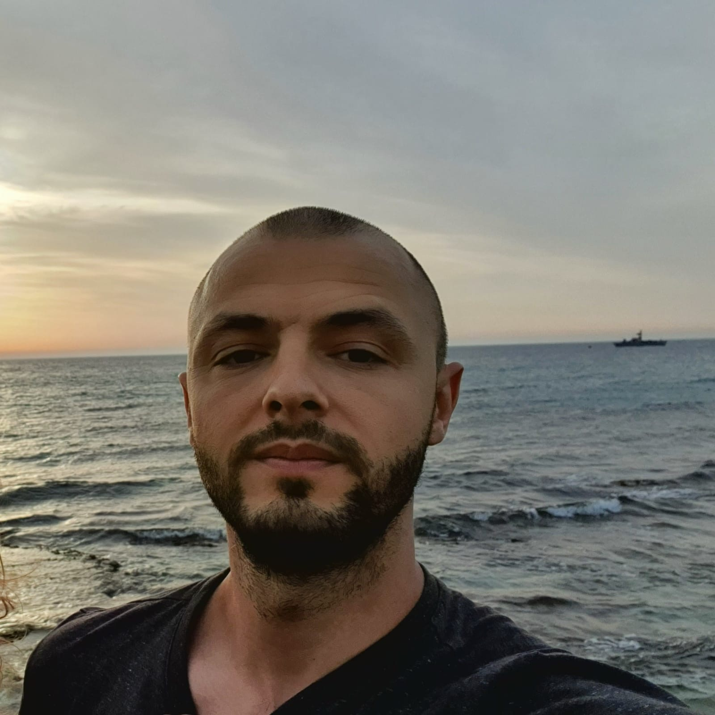
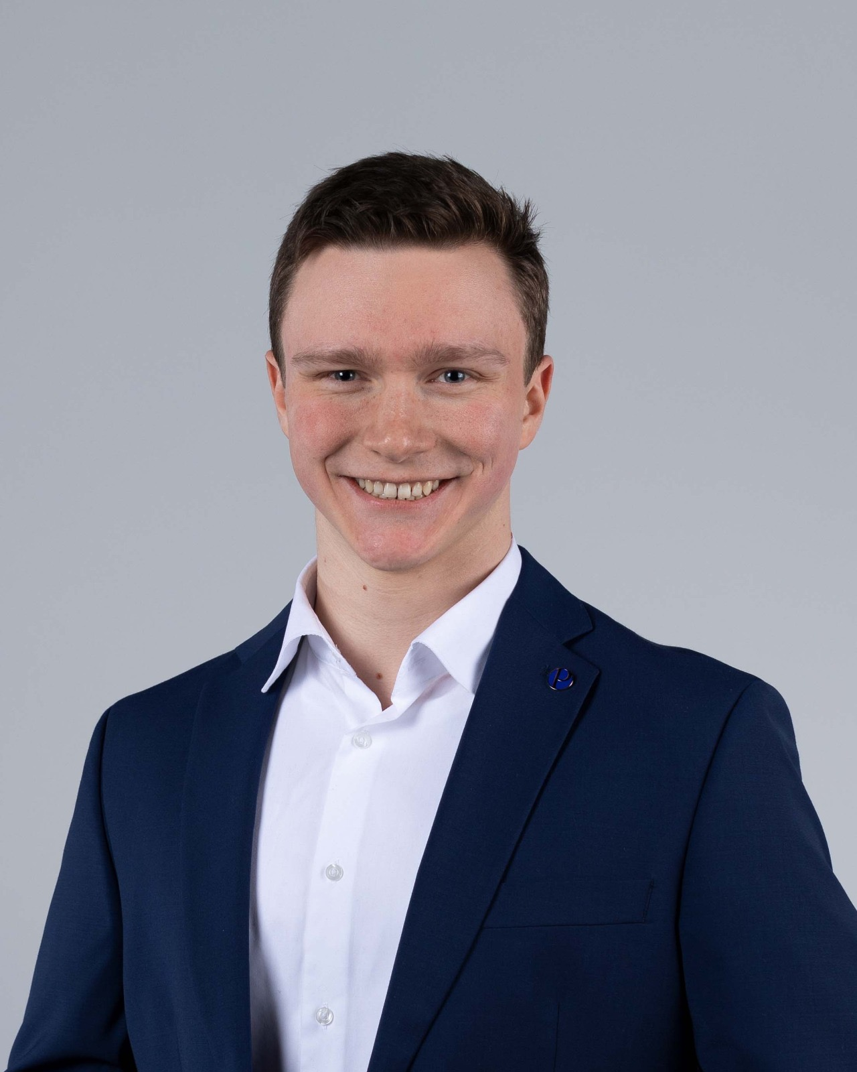
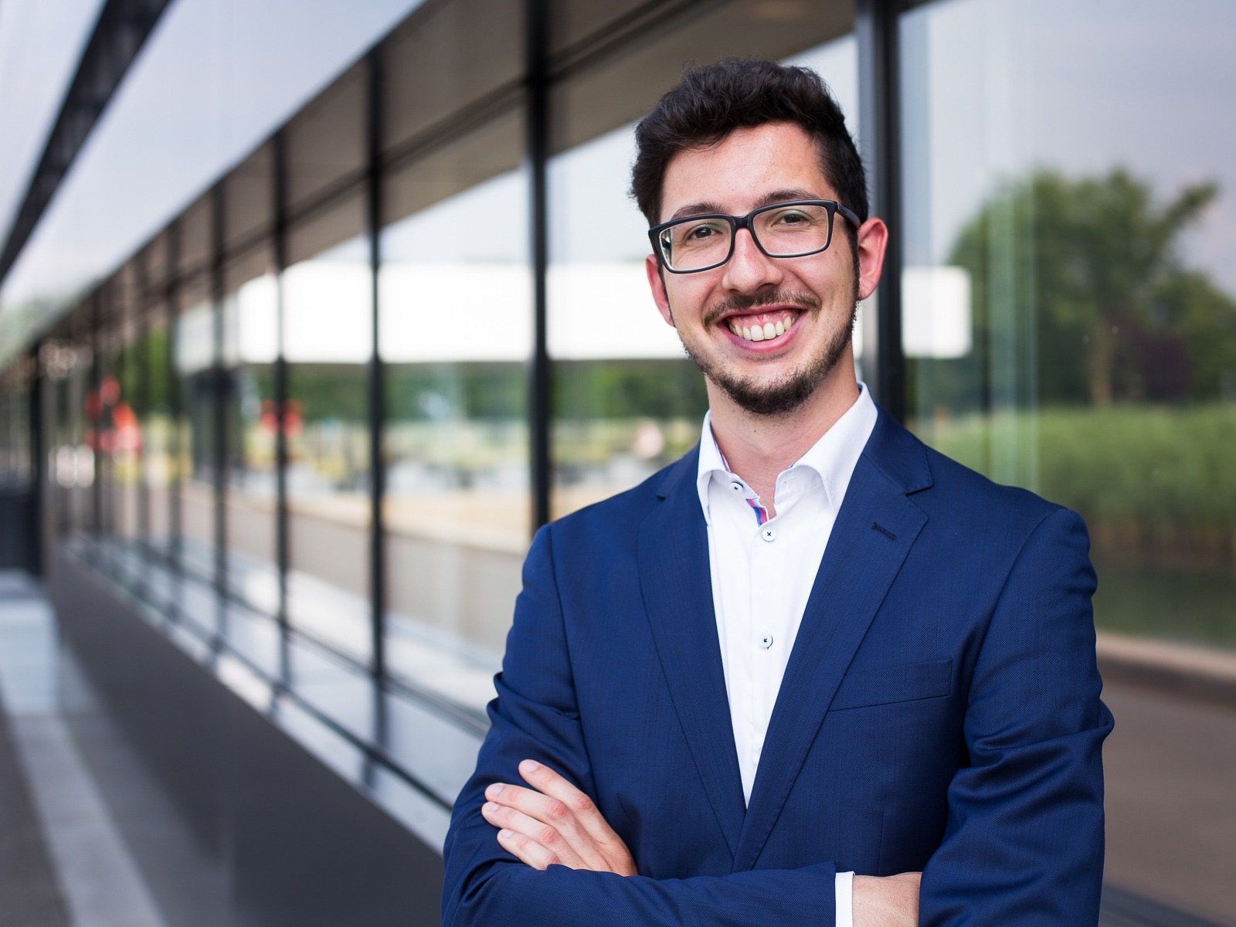

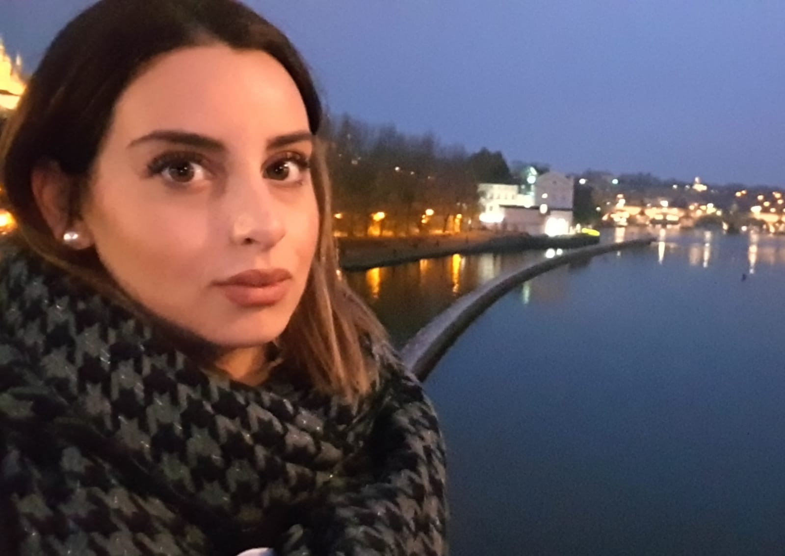

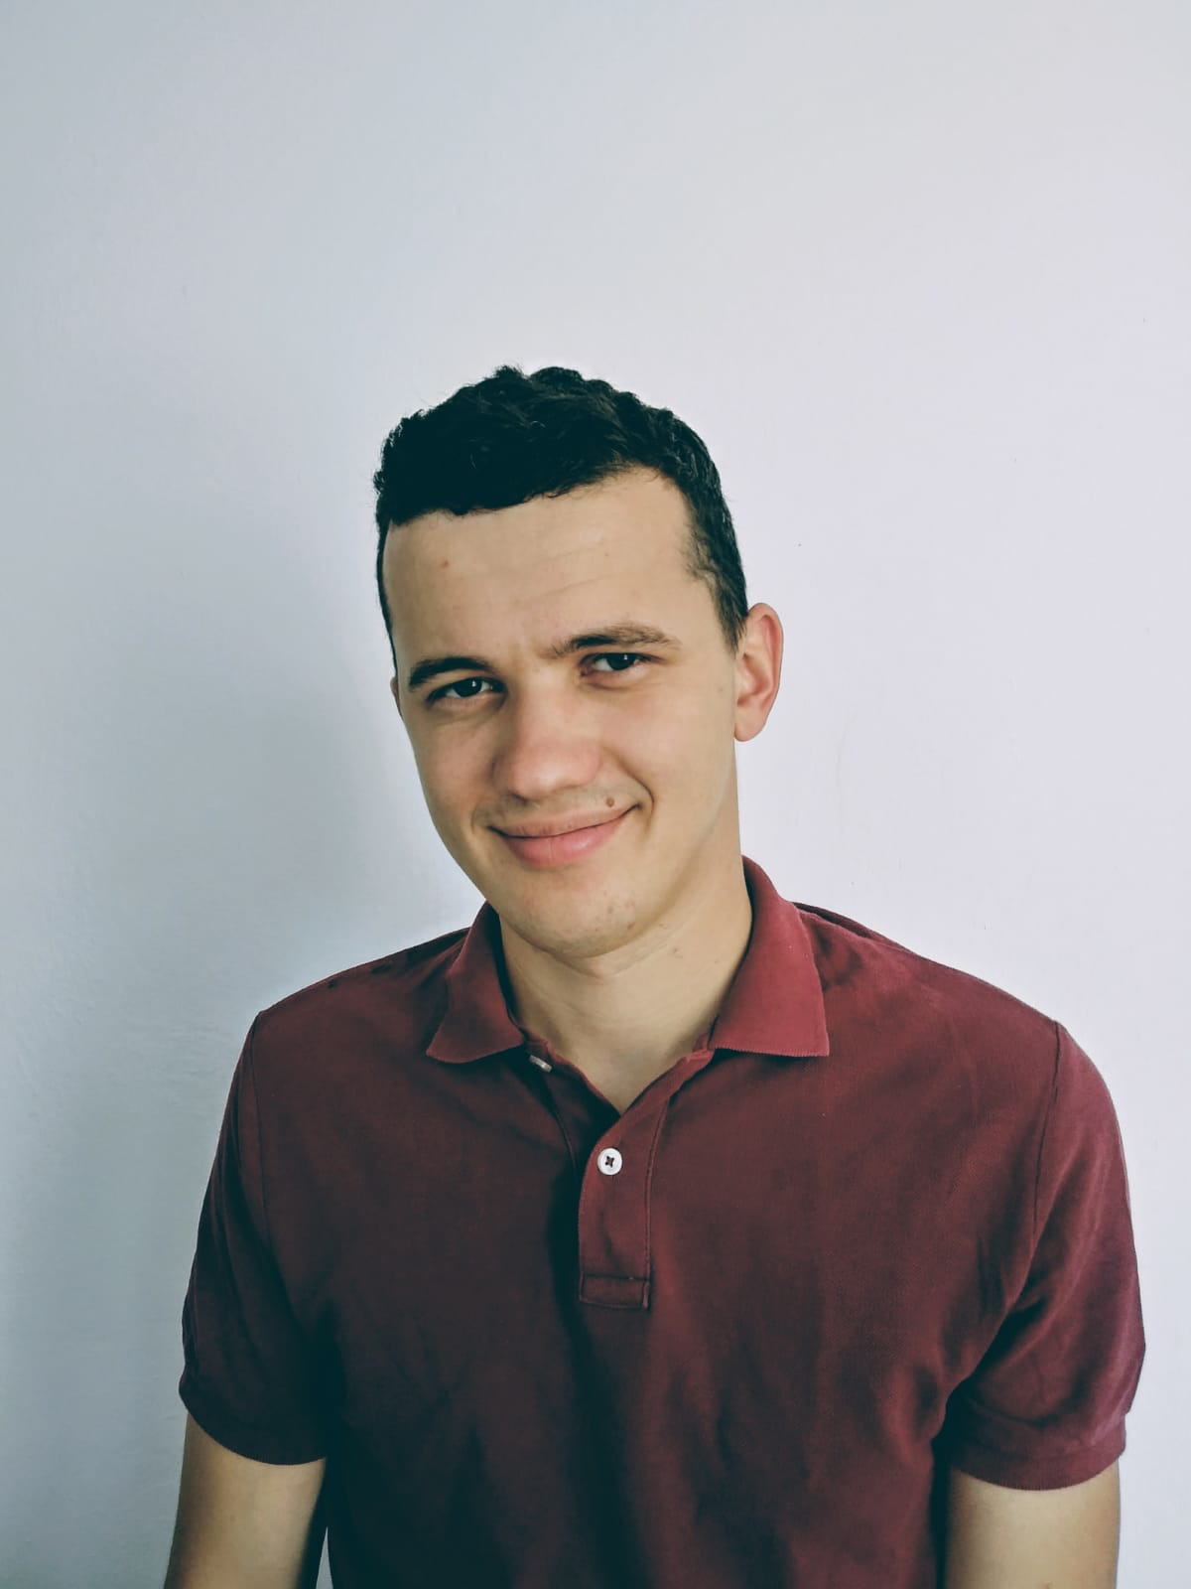

OUR TEAM
Danny Rozenberg
Tim Jäger
Metin Erol Sik
Liat Machli
CEO
Speaker and Sales Manager
CTO Tech Expert
Research Expert
Nensi Lončarić
Monika Maria Liwińska
Ivan Marinac
Martina Mikulčić
Content Manager
Marketing Leader
Chief Designer
Content Manager

Slide 3
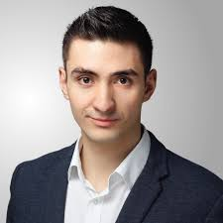

ENRICO BERARDONE
Notes:
(Intro) meet enrico

Slide 4
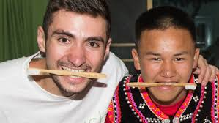
ENRICO´S COMPANY
  Helps people by donations
  Reduces plastic pollution

Slide 5
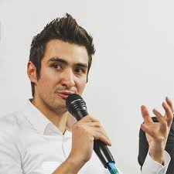
ENRICO´S CHALLENGES
Finding the right non-profit
Remaining profitable
Notes:
Now that we met enrico… we`ll present you…

Slide 6
MARKET- PROBLEM
social entrepreneurs have great ideas and intentions! But…
They are having trouble finding those they what to help
In most cases, sustainable products cost more to produce
How many social enterprises are there?
In the UK alone almost 500 K social enterprises*
Only half of them are profitable**
*https://www.redbull.com/my-en/social-enterprise-stats
**https://assets.publishing.service.gov.uk/government/uploads/system/uploads/attachment_data/file/507236/SOCIAL_ENTERPRISE-_MARKET_TRENDS_2015.pdf

Slide 7
MARKET- CURRENT SOLUTIONS
What are their current solutions?

Slide 8
WHO ARE WE?
Notes:
Elevator pitch

Slide 9


Slide 10
ONE SOLUTION - ON ONE PLATFORM
  A. Connect social entrepreneurs with non profits
  B. Promote those entrepreneurs and their products
  C. Help them to be profitable
Notes:
We offer an Online platform to:
help social entrepreneurs connect with non-profits
remain profitable
While supporting them by a whole ecosystem

Slide 11
TECHNOLOGY TREND
- THE AUTONOMOUS AGENTS
The No.1 trend in “Gartner Top 10 Strategic Technology trends”
Use the AI agents to to function as a highly intelligent search tool
Provide the platform’s users necessary information that connect between entrepreneurs to social organizations

Slide 12
KEY FRAMES FROM THE PLATFORM?
Notes:
solution

Slide 13
  SOLUTION
  Connect social entrepreneurs with non profits
We will use AI technology to learn form the data created from answers and provide the most relevant search results
  Promote entrepreneurs and their products
  Help social entrepreneurs to be profitable
Notes:
Help social entrepreneurs in their search for non-profits to donate to
Help non-profits in their search for donations from social entrepreneurs
Each user will answer a few questions to define his search
Help Promote entrepreneurs on their first steps by presenting social news on the platform and international PR
We’ll display social entrepreneur's products and promote them on the platform, as well as on our marketing, PR and social media channels
We`ll connect the entrepreneurs to media, PR experts and marketing agency’s for low-cost group-prices
We`ll provide entrepreneurs with the best marketing tips on the platform`s blog
Reduce their costs by connecting with the best-value suppliers
Increase income by giving them tools for business success
We`ll give them a whole ecosystem and community to support those efforts

Slide 14
  BUSINESS MODEL
Cost Structure
Software development ; IT; Website maintenance
Advertising/marketing; PR; Lobbying
Salaries; contributions; Insurance
Revenue Streams
2% fee for any transaction
Product promotions (Advertising)

Slide 15
  KEY PARTNERS
Social entrepreneurs
Non–profits
Specialized technology providers (AI, Web Service)
Manufacturing companies
Marketing, PR and sales partners
Notes:
last but not least partner- you!

Slide 16
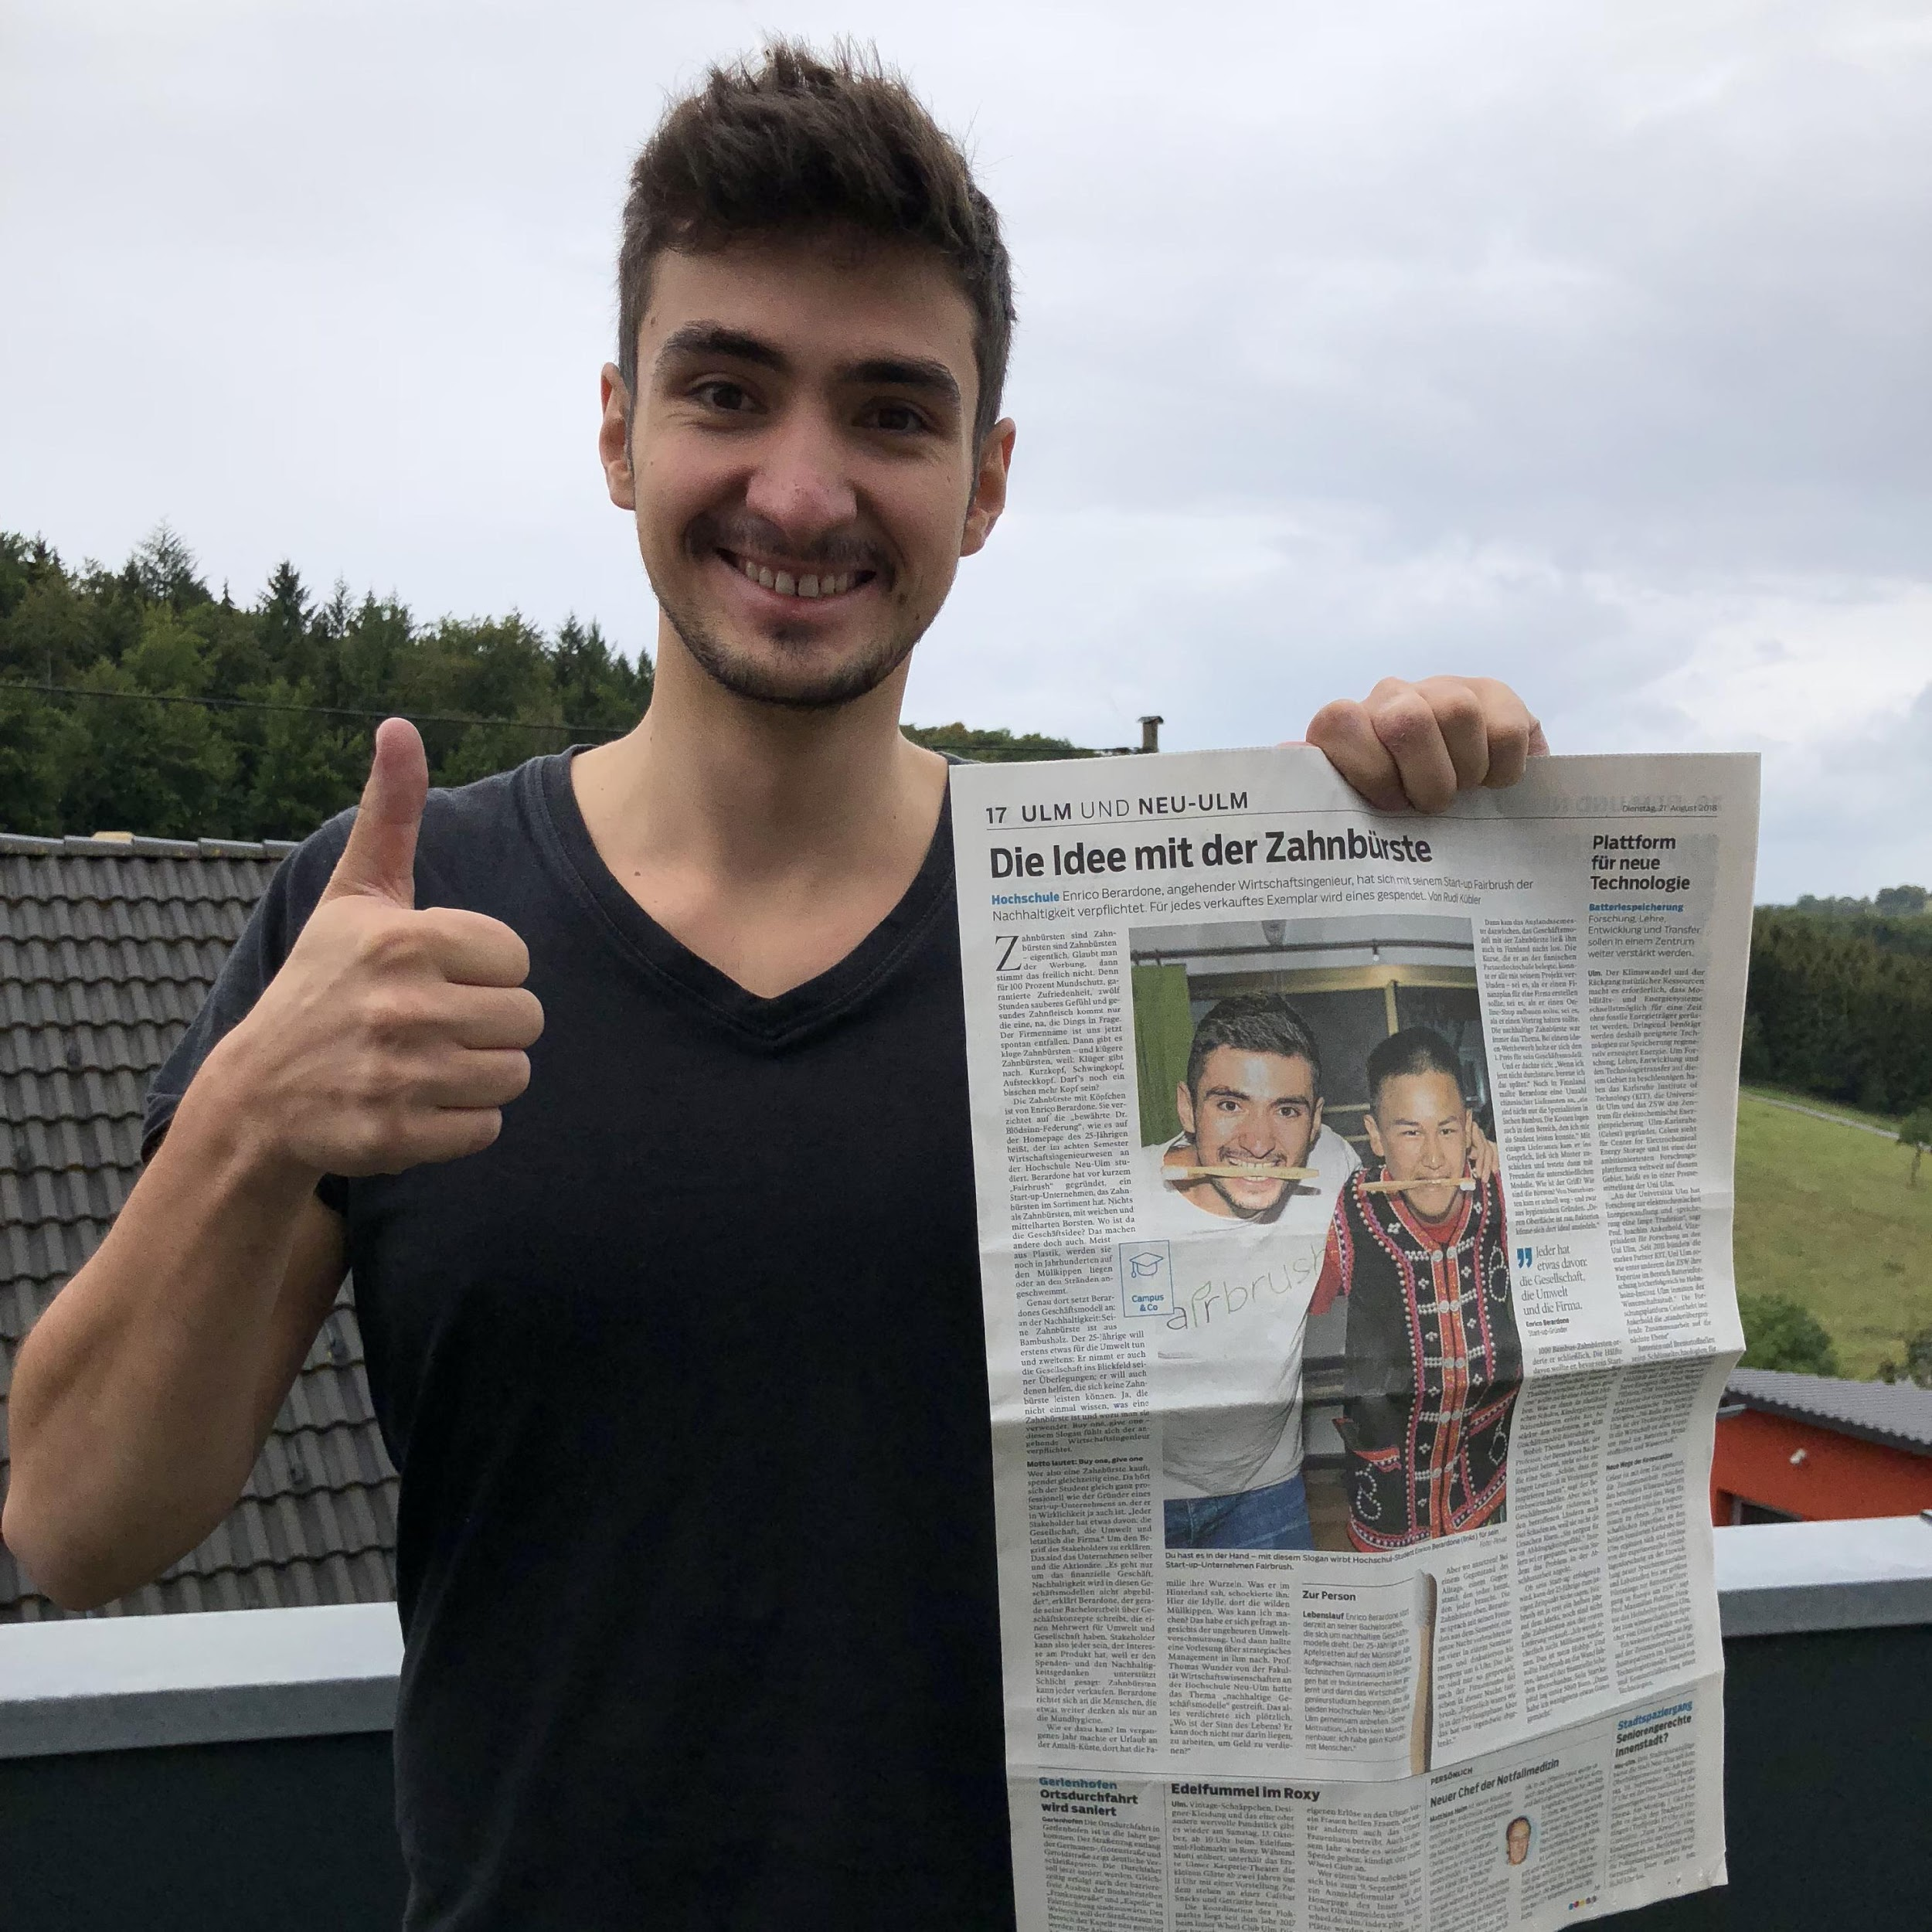
JOIN US!
MAKE THE WORLD A BETTER PLACE
Thank you!
Notes:
join us! And help Social entrepreneurs like enrico become successful and profitable while making the world a better place

