Slide 1
Na’ama Avidan - Israel
Ivana Radić - Croatia
Bakir Peljto - Bosnia and Herzegovina
Annika Nowack - Germany
8
Shir Golan - Israel
Oren Markbreit - Israel
Charles Piel - France
Marija Perković - Croatia
Denisse Radin - Croatia

Slide 2
Children screen time

Slide 4
What do they really feel?
Notes:
The Problem: This has never been an easy thing for companies to determine. For one thing, emotions are inherently difficult to read. For another, there´s often a disconnect between what people say they feel and what they actually feel.
A lot of companies use focus groups and surveys to understand how people feel. They take a lot of time. Especially to get the feedback from children. There are plenty of apps for them but nobody knows if they like it or not.
->next slide
Now, emotion AI technology can help businesses capture the emotional reactions in real time – by decoding facial expressions, analysing voice patterns, monitoring eye movements, and measuring neurological immersion levels, for example. The ultimate outcome is a much better understanding of their customers – and even their employees.

Slide 5
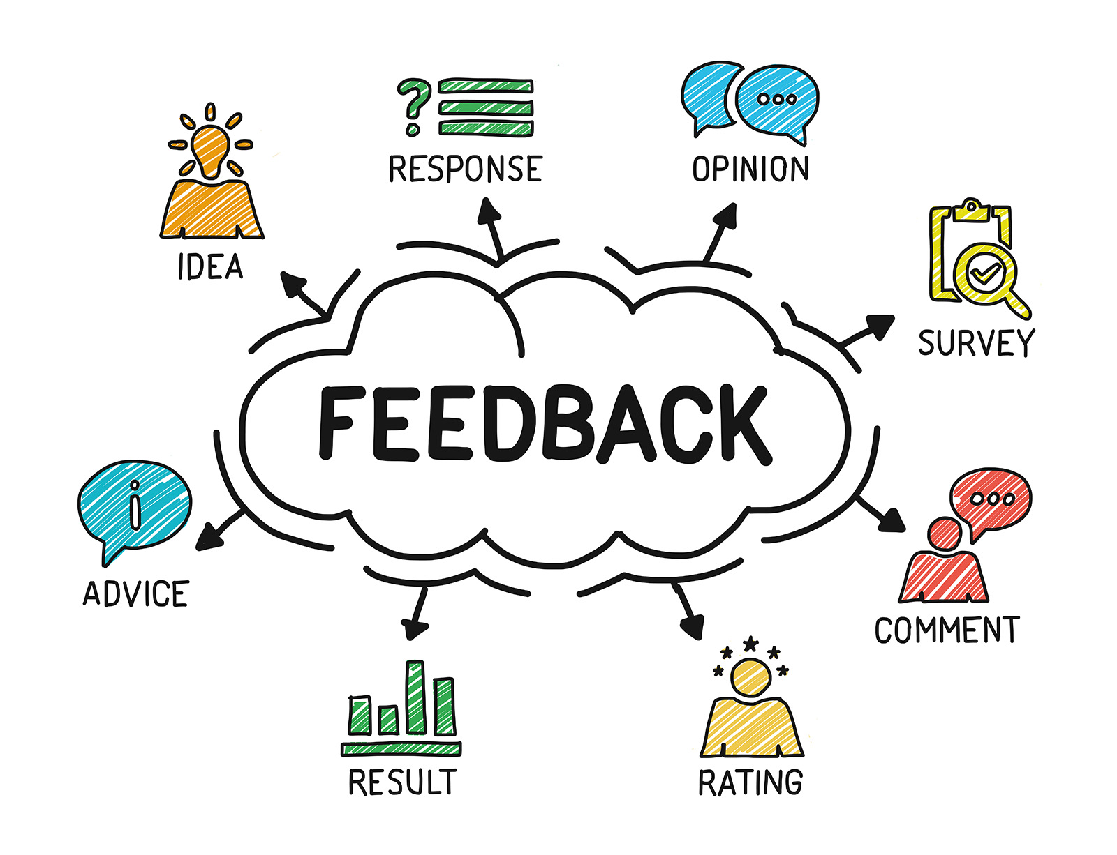
Feedback is important
Notes:
Effective feedback, both positive and negative, is very helpful. Feedback is valuable information that will be used to make important decisions.
Feedback promotes personal and professional growth.
Customers opinions about experience they have with brand is helpful information that you we use to adjust your business to fit their needs more accurately. Customer feedback is information provided by clients about whether they are satisfied or dissatisfied with a product or service and about general experience they had with a company. Their opinion is a resource for improving customer experience and adjusting your actions to their needs.

Slide 8
Emotion,
Non-verbal
communication
Notes:
In some situations it is very difficult to get feedback especially when it comes to children.
Children in most cases give feedback through emotion and non-verbal communication and therefore it is almost impossible to get written feedback from a child.
Children often do not leave feedback in the classic way as adults, so it is necessary to develop a new model to make it easier to get feedback from them.

Slide 10
EAI Feedbacker
Background app

Slide 11
EAI Feedbacker
Background app
Scans reactions

Slide 12
EAI Feedbacker
Background app
Scans reactions
Analyzing

Slide 13
EAI Feedbacker
Background app
Scans reactions
Analyzing
AI on Big Data

Slide 14
EAI Feedbacker
Background app
Scans reactions
Analyzing
AI on Big Data
Sends Feedback

Slide 15
What is unique about our solution?

Slide 16
Growth potential

Slide 17
Autism

Slide 18
Education

Slide 19
Medical diagnosis

