Slide 1


"A big business starts small"

Slide 2
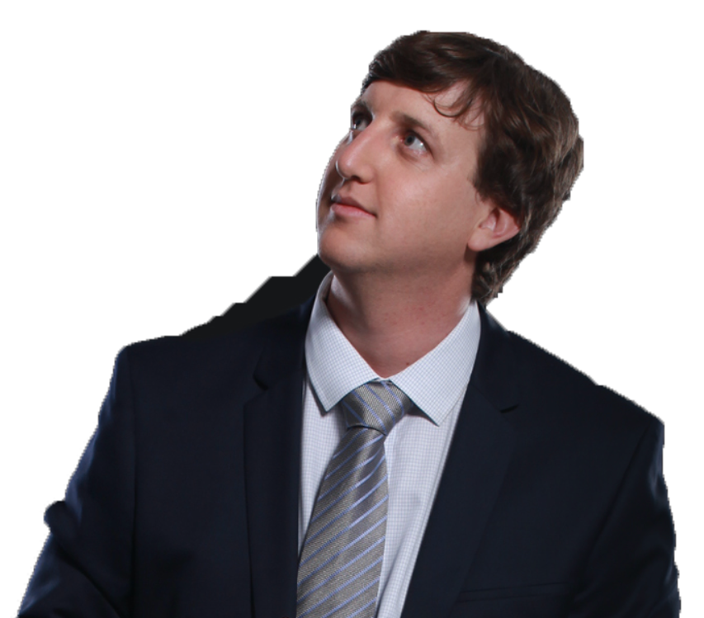
Gal
GKI Group’s founder and President

Slide 3
Agenda
The problem
The idea
Realization
Why us?

Slide 4



The problem
The problem The idea Realization Why us?

Slide 5

The idea
The problem The idea Realization Why us?

Slide 6
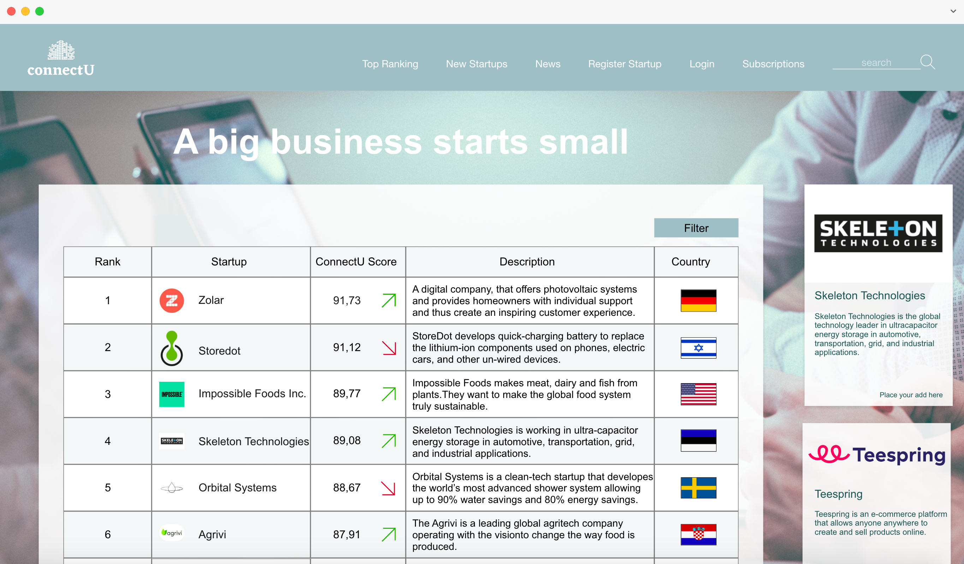
Realization
The problem The idea Realization Why us?

Slide 7

Why us?
The problem The idea Realization Why us?

Slide 8
"A big business starts small"

