Slide 1


Slide 2


Slide 3

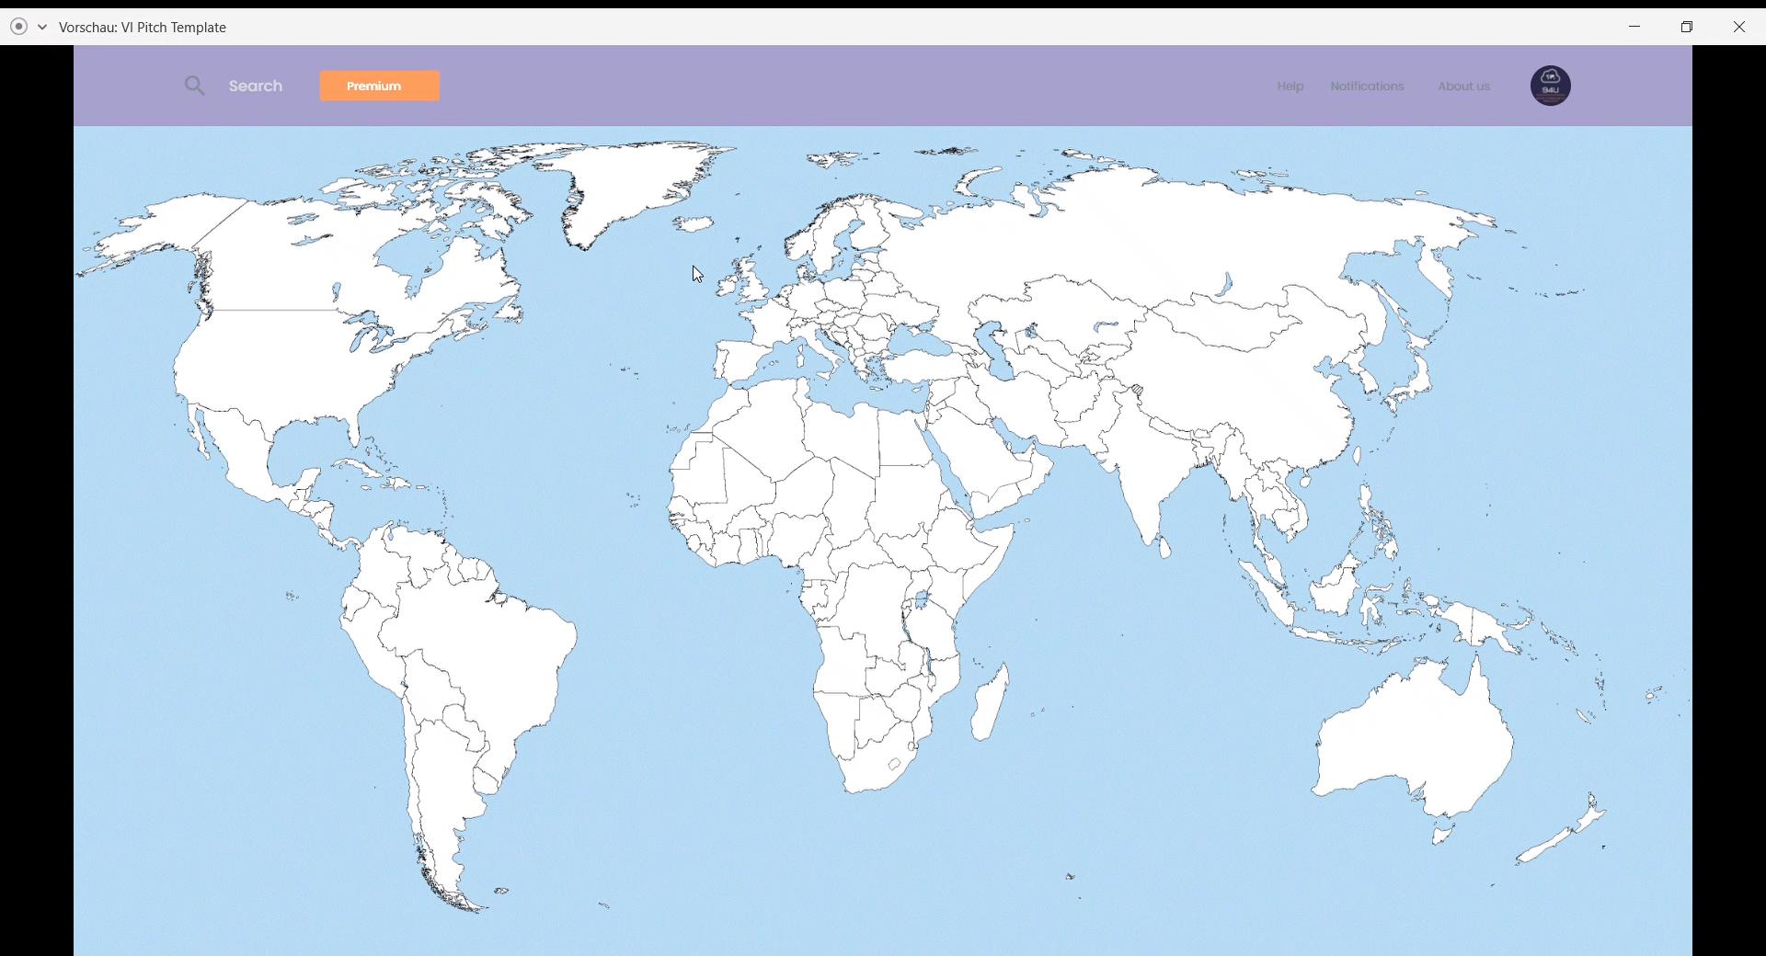

Slide 4




ABOUT US
THE MARKET
WHY US?
DISTRIBUTED CLOUD

Slide 5
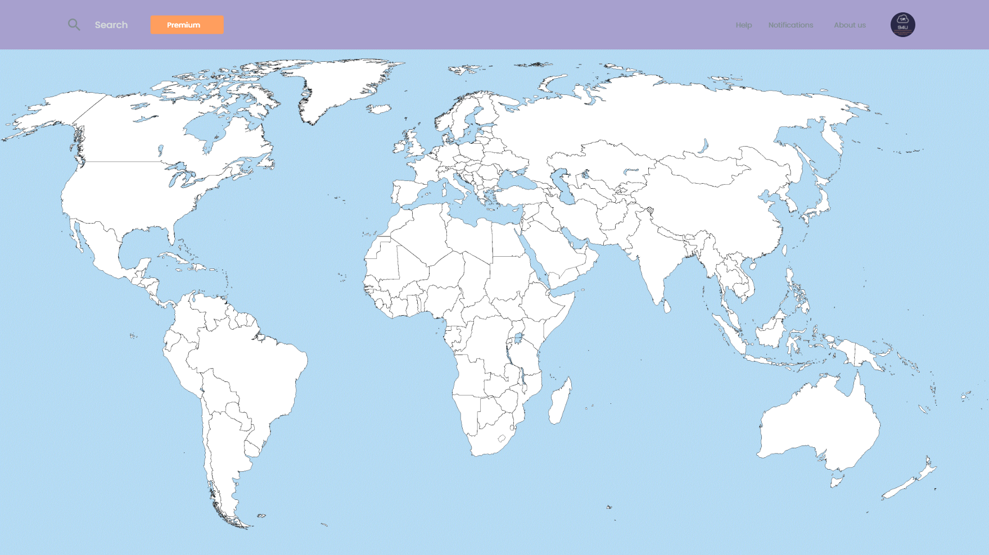













Slide 6
BUSINESS PLAN
Raising money
and
employee recruitment
Collaboration with governments
Website development
Massive advertising of our website
Profits from advertising and membership fee
2020 – Q3
2020 – Q3
2020 – Q4
2021 – Q1
2021 – Q3

Slide 7
ADVERTISING
SALARIES
MEMBERSHIP FEES
MARKETING
SERVER,
DOMAIN AND
CLOUD RENT
REVENUE
$120 000
COSTS
$80 000

Slide 8

PROFIT
$40 000
REVENUE
$120 000
COSTS
$80 000

Slide 9


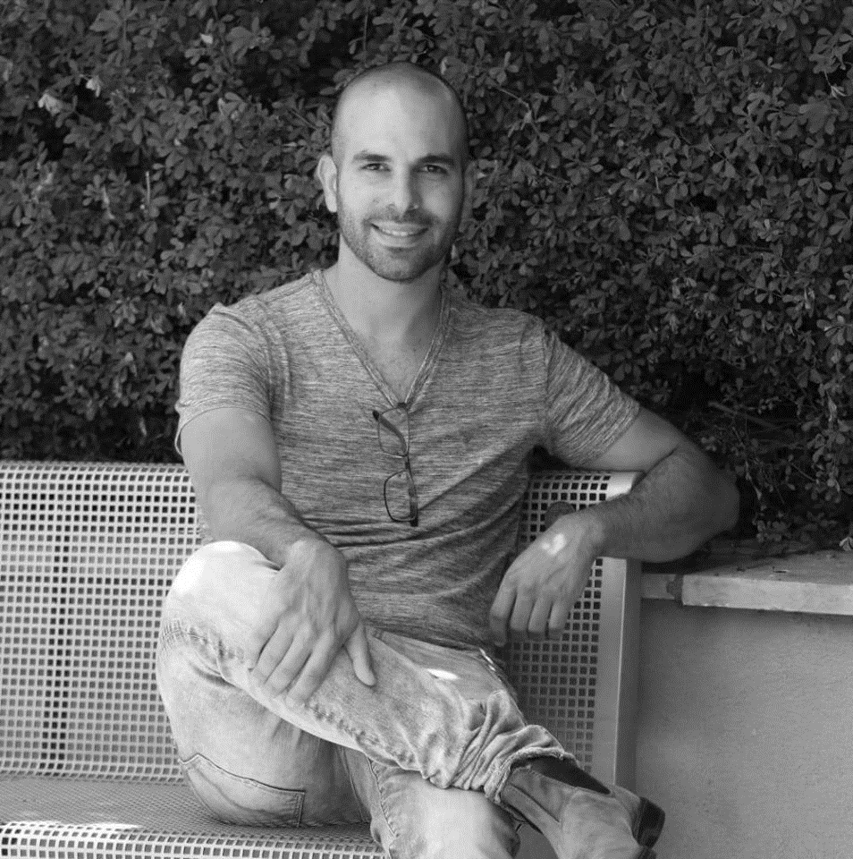
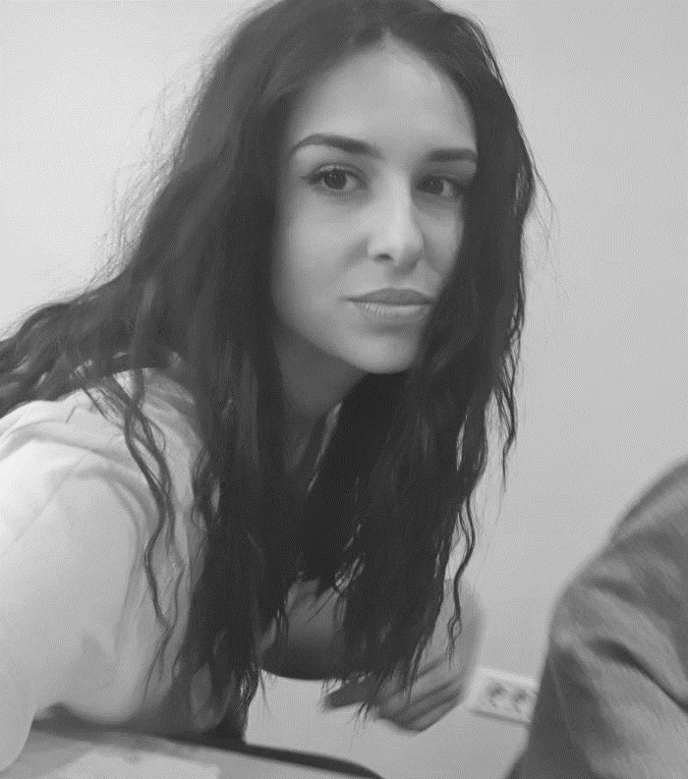
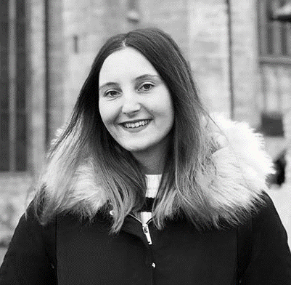
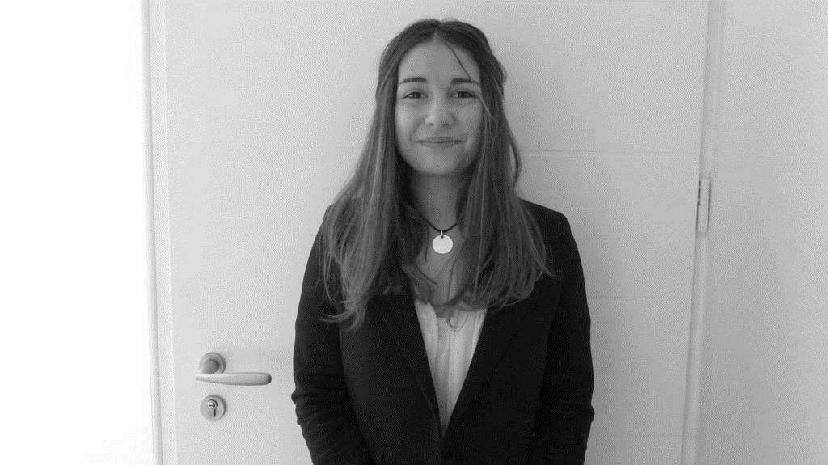


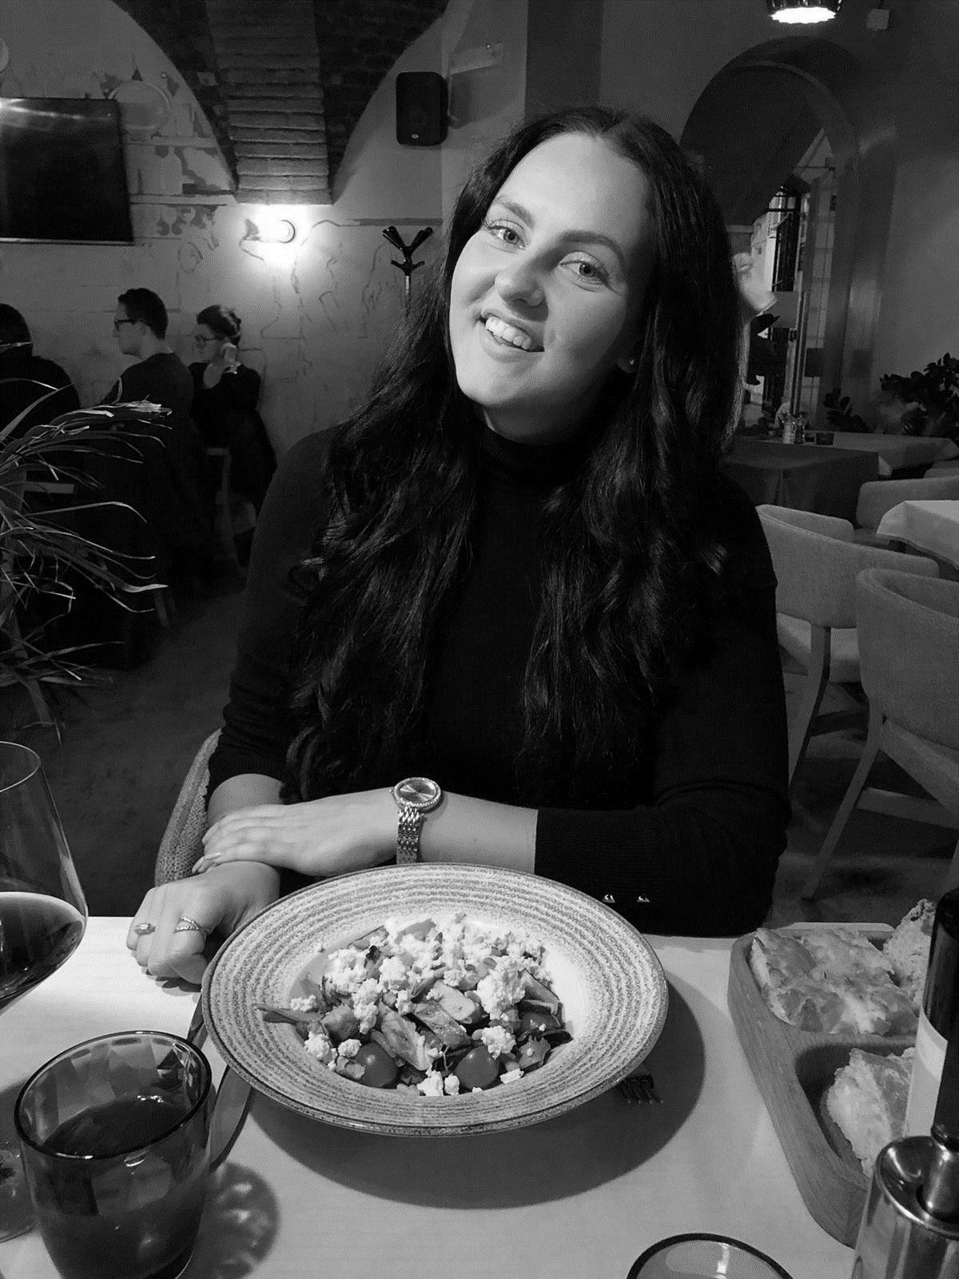
OUR TEAM
CEO
Dahoud
IT Manager
Patricia
Finance Manager
Dor
Sales Manager
Ivana
Research Specialist
Veronika
Web Designer
Louise
PR Manager
Fabian
Research Specialist
Marija
Marketing Manager
Lana

Slide 10
“It’s quite a helpful idea for staying up-to-date with all regulations during the pandemic.”
- Cofounder of ThisCounts
“Great idea to have all the information that you need to keep up with situations all around the world!”
- Director of Pametno Putovanje 2
“I find it very helpful, especially because my company is exporting to other countries and I would definitely use this site.”
- Director of Alpha Energy
“This is a great idea!
It would help me a lot in this time of crisis.”
– Director of Izmus
“Very good thinking. Very helpful solution.”
- Director of Bit4Bytes

Slide 11

“It’s quite a helpful idea for staying up-to-date with all regulations during the pandemic.”
- Cofounder of ThisCounts
“Great idea to have all the information that you need to keep up with situations all around the world!”
- Director of Pametno Putovanje 2
“I find it very helpful, especially because my company is exporting to other countries and I would definitely use this site.”
- Director of Alpha Energy
“This is a great idea!
It would help me a lot in this time of crisis.”
– Director of Izmus
“Very good thinking. Very helpful solution.”
- Director of Bit4Bytes

