Slide 1

“Bringit”

Slide 2
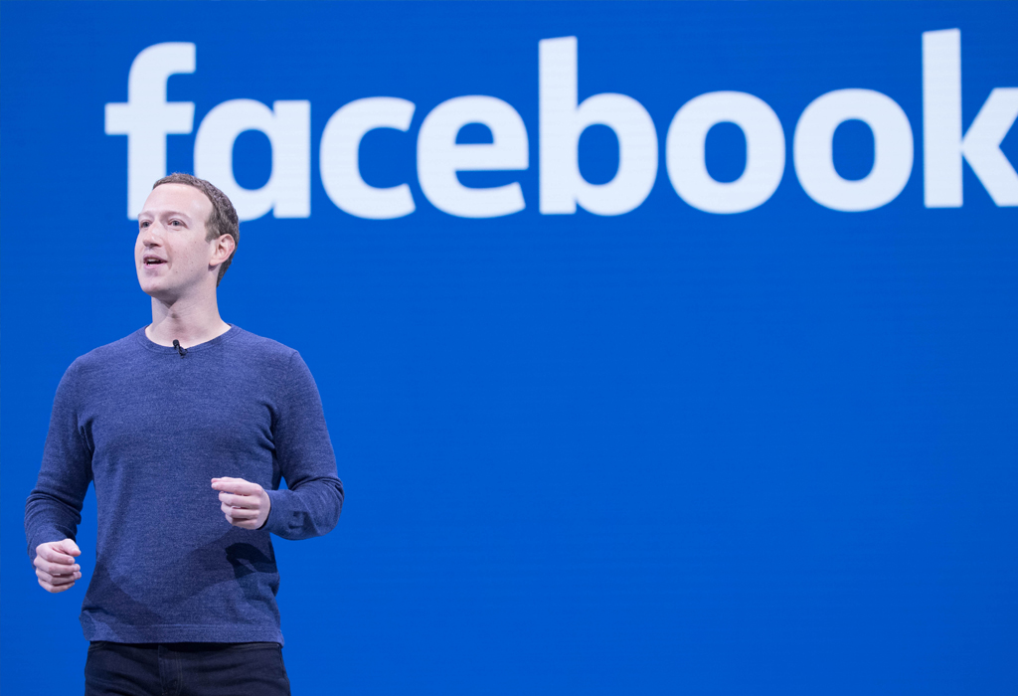

Slide 3

ProblEms
lack of manpower / time
Multiple skills needed
Many data types: synthetic, production, H.R, economy, energy ect’
focus on the key point – out of large amount of data

Slide 4

Bringit
The vision

Slide 5

Our solutions
Delivering analyze information right to your hand
  Fast access to exact data
  Customized focus on data and customized analysis
  Time saving – risk reduction

Slide 6
How does it work?
Consultant organization meeting
01
Consultant & BRINGIT - matching expectations
02
BRINGIT & organization - access to data
03
Adjust the focus of the analysis with the consultant
04
Information is analyzed
05

Slide 7

Our uniqueness/ technology
Information collection from all sources automatically - machine, cameras, personally, computers act’
The analysis capabilities will rely on an AI
Advanced information security system
Storing large amount of data -
“next generation memory”
Large data type collection
AI analyze

Slide 8
opportunity
300$ per hour - 1200$ for only one consulting hour
pricing consultancy for medium corporation - 12,000$

Slide 9
Go to market strategy
Quick And Dirty – Get Feedback And Make Changes
Connect With Big Corporations – Create Reputation & Experience
(We will start with a free service)
Exclusive Contract With Consultants
Small Market – Israel

Slide 10
Business model - Lean Startup
B2B
Freemium model - paid by the consulting company
(Just the data without the analysis)

Slide 11
Scale up strategy
4Q - 2020
MVP
Few services
3Q 2021
FULL PLATFORM
3Q 2022
U.S MARKET

Slide 12
Our team
Consultants
AI - Technology Professionals
information Security
The perfect team!

Slide 13

Thank You for your time!
We are Looking forward to a Further collaboration!

Slide 14
GROUP 5
Jan-philipp stöhr - C.E.O
Doron ratzon - C.O.O
Sandra bulić - C.F.O
Antonio ledenko - C.T.O
Yotam braitbart - V.P PRODUCT
Marijana Kozlović - C.M.O
Dunja kozulić - R&D
Barbara kruhek - H.R

