Slide 1
EVALUATION OF THE VALIDITY OF SCIENTIFIC RESEARCH

Slide 2
Empirical cycle
1. Observation
2. Induction (hypothesis)
3. Deduction (prediction)
4. Testing
5. Evaluation

Slide 3
Evaluation phase
CONDITIONAL support of the hypothesis in case of confirmation !
Rejecting the hypothesis in case of refutation ?
And adjust the hypothesis?
Why do we call a cycle a cycle?

Slide 4
Reliability and validity
Reliability - replication
Validity (3 types) - reflects the actual situation
  Component - if the constructs are accurately measured
  Internal - causal connection
  External - generalization

Slide 5

EXAMPLE OF RESEARCH (1)
H 0 : There is no statistically significant positive association between physical activity and student achievement
H 1 : There is a statistically significant positive association between physical activity and student achievement
Design:
Random sample of 100 1st year FET students
Ten months of free gym membership (10/2020 - 6/2021)
Random sample of 100 students
50 students
CONTROL GROUP
50 students
EXPERIMENTAL GROUP

Slide 6
EXAMPLE OF RESEARCH (2)
Construct 1: Student physical activity
Construct 2: Success in student study
Variable 1:?
Variable 2:?

Slide 7
EXAMPLE OF RESEARCH (3)
Examinee | Var 1 | Var 2
1 | 5 | 1
2 | 0 | 0
3 | 1 | 1
4 | 3 | 2
5 | 5 | 3
… | … | …
99 | 1 | 1
100 | 10 | 4
Construct 1: Student physical activity
Construct 2: Success in student study
Variable 1: Number of hours spent in the gym per week
Variable 2: Teaching activity measured
by the number of attendances per week
Positive relationship !!!

Slide 8
EXAMPLE OF RESEARCH (4)
H 0 : There is no statistically significant positive association between physical activity and student achievement
H 1 : There is a statistically significant positive association between physical activity and student achievement
H 0 : There is no statistically significant positive relationship between the number of hours spent in the gym per week and the number of attendances per week X
H 1 : There is a statistically significant positive relationship between the number of hours spent in the gym per week and the number of attendances per week ☺

Slide 9
EXAMPLE OF RESEARCH (5)
Has the component validity been met?
There is a statistically significant positive relationship between the number of hours spent in the gym per week and the number of attendances per week = There is a statistically significant positive relationship between physical activity and student achievement
Do the selected variables measure the constructs from our study? Or measure something else?

Slide 10
EXAMPLE OF RESEARCH (6)
There is a statistically significant positive relationship between the number of hours spent in the gym per week and the number of attendances per week = There is a statistically significant positive relationship between students 'motivation to go to the gym and students' extroversion
There is a statistically significant positive relationship between students 'motivation to go to the gym and students' extroversion ≠ There is a statistically significant positive relationship between physical activity and student achievement
Component validity not met

Slide 11
EXAMPLE OF RESEARCH (7)
Is internal validity met?
There is a statistically significant positive association between physical activity and student achievement
Is external validity met?
student achievement

Slide 12
4 criteria of causality
Cause and effect are related
Cause precedes consequence
Cause and effect happen consistently together
We can reject alternative explanations

Slide 13
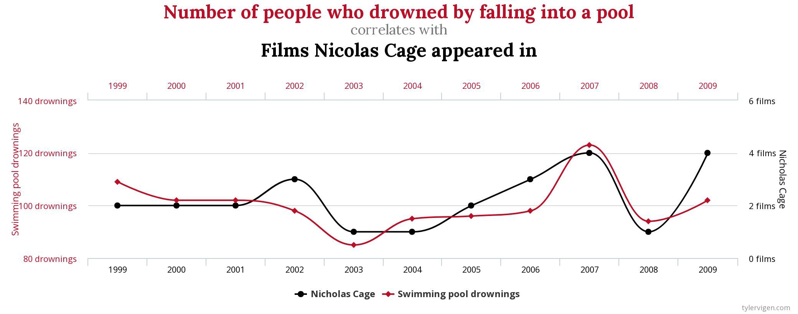
Causality ≠ correlation
Causality implies correlation but correlation does not necessarily mean causality
Source: Flender, S., Correlation does not imply causation, https://towardsdatascience.com/correlation-does-not-imply-causation-92e4832a6713

Slide 14
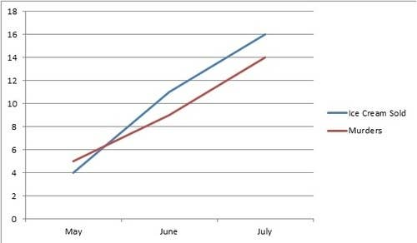
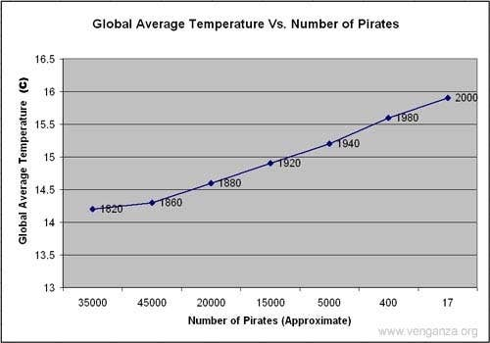
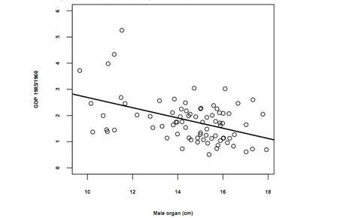
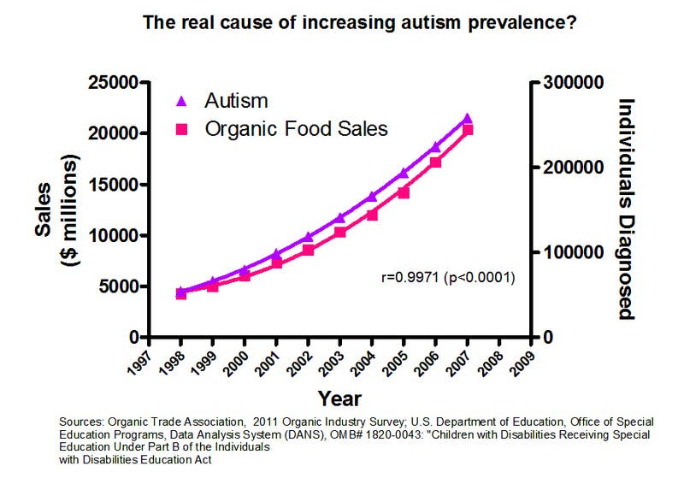
Fun facts - most bizzare correlations
Ice cream consumption leads to murder.
A pirate shortage caused global warming.
Living in a poor country increases penis size.
Eating organic food causes autism.

Slide 15
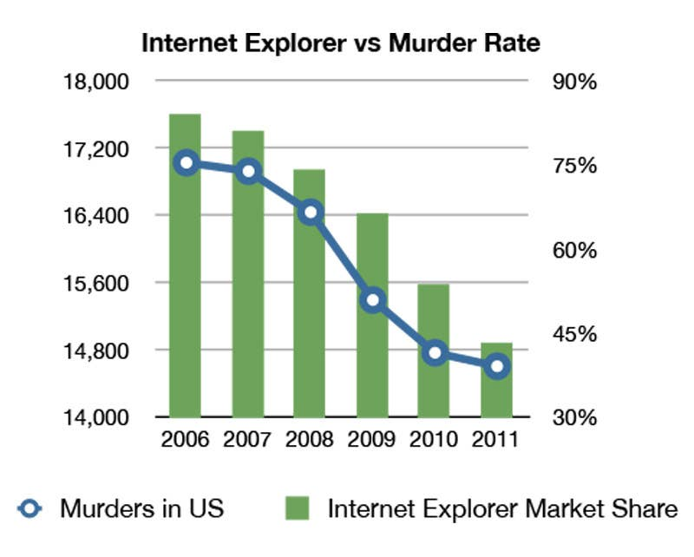
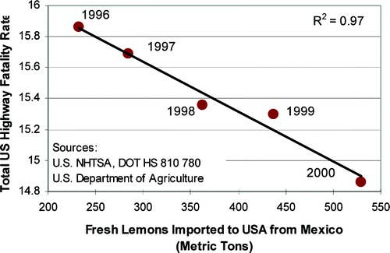
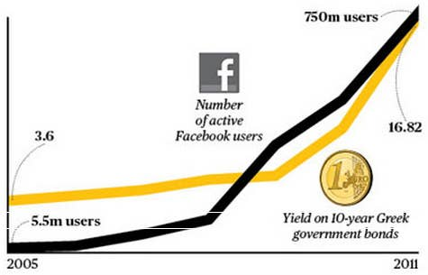
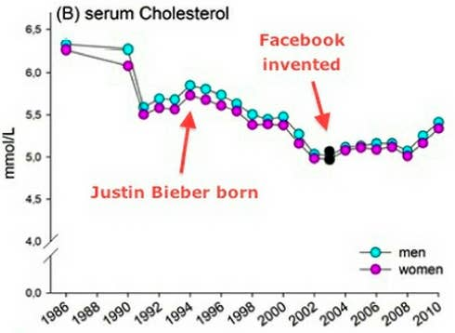
Using Internet Explorer leads to murder.
Mexican lemon imports prevent highway deaths.
Facebook also canceled out the cholesterol-lowering effects of Justin Bieber.
Facebook caused the Greek debt crisis.

Slide 16
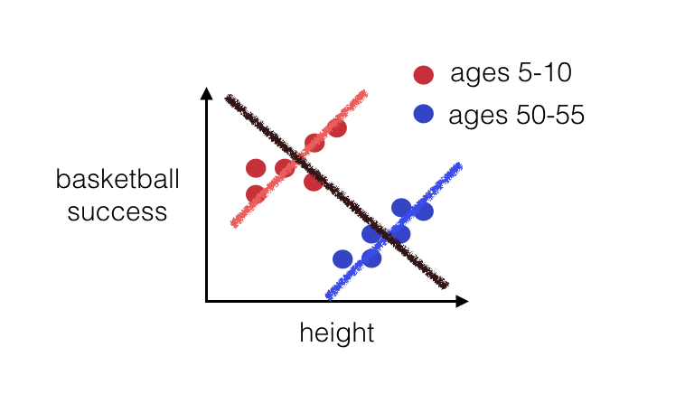
Simpson's paradox - a paradox in grouping data

Slide 17
Threats to internal validity
Considering:
  Participants
  Tools
  Unnatural / artificial reactions
  Design / procedures

Slide 18
Ad 1) Threats to internal validity - participants
  1.1. Maturation - natural change - alternative explanation due to natural change (can be eliminated by introducing a control group)
  1.2. Selection - characteristics of selected subjects - differences in the characteristics of selected subjects (can be eliminated by introducing a control group, pre-test and random selection)

Slide 19
Ad 2) Threats to internal validity - instruments
2.1. Low construct validity - when we measure another construct or property with an instrument, not what we observe.
  2.2. Instrumentation - if the instrument changes - if the measuring instrument changes during the survey.
2.3. Testing (sensitivity) - conducting testing or any measurement procedure can affect the behavior of people involved in research.

Slide 20
Ad 3) Threats to internal validity - artificial reactions
3.1. The effect of researchers' expectations - researchers ' bias, unconscious change in researchers' behavior. This can be solved through a research design that is unknown to the researcher, ie the researcher in this case does not know what to expect from the research participants.
3.2. Demand characteristics (double-blind + story) - if participants know they are part of the research, changes in their behavior may occur. It creates an additional problem if participants from the experimental and control groups react differently to the knowledge that they are part of the research. The solution would be for participants not to know if they are in a control or experimental group. If we also remove the potential influence of researchers, then we call this double-blind research design.

Slide 21
Ad 4) Threats to internal validity - design / procedures
4.1. Ambiguous time advantage - whether the cause precedes the consequence (indicates a situation when we are not sure whether our hypothetical cause precedes the observed consequence - eg inflation and money supply).
4.2. History - if an unforeseen event occurs during research that can provide an alternative explanation (example of a baby and a stork - a hidden variable).
4.3. Mortality - participants exit the study

Slide 22
Differences between concepts
Constructs - Construct as a term is used to emphasize that we are talking about a general property, an abstract concept. For example, a construct can be physical fitness or success in studies.
Variables - operationalization of the construct
  Dependent - consequential, result or output variables, depend on independent variables
  Independent - causal, explanatory, input or predictor variable, affect the dependent variable
  External
    Hidden
    Control
    Background

Slide 23

TASK
H 0 : There is no statistically significant association between violent video game play and child violent behavior
Explain:
  Construct and variables
  Four criteria of causality (causality)
  Three types of validity
  Traps of internal validity

