Slide 1
SAMPLING
The quality of individual research " falls " or " pro Iazi", only on the appropriateness of methodology and instruments, but also on whether the appropriate sample selection strategy has been adopted !!!

Slide 2
SAMPLING (1)
Part of our everyday life… we estimate an unknown characteristic of the population !!!
Why do we choose a sample on which to conduct research?
  Pragmatic reasons (budget, time)
  Accurate and reliable results
  Breaking down units of observation
The sample is used to estimate the characteristics of the basic set, and the statistical method determines the reliability and accuracy of that assessment - all these procedures make up a method called the sample method !!!
We use the sampling method to:
(1) assessment of population characteristics,
(2) deciding whether to accept or reject a particular assumption (hypothesis) relating to a population characteristic

Slide 3
SAMPLING (2)
Population - a basic set that includes all respondents who have some common characteristics
Sample - that part of the population that representatively represents the population in all its characteristics
Sampling - the process of selecting a part of a population that representatively represents the entire population. A sample is representative if it resembles a population in its basic characteristics, because then it becomes a reduced image of the basic set, ie the population.

Slide 4

1st photo, 2nd photo (2000 points), 3rd photo (1000 points), 4th photo (250 points)

Slide 5
SAMPLING (3)
Four key factors in sample selection:
  Sample size
    Population nature (size and heterogeneity)
    Type and purpose of research
    Number of variables and statistical tests
  Representativeness and basic parameters of the sample
  Sample access
  Sample selection strategy

Slide 6
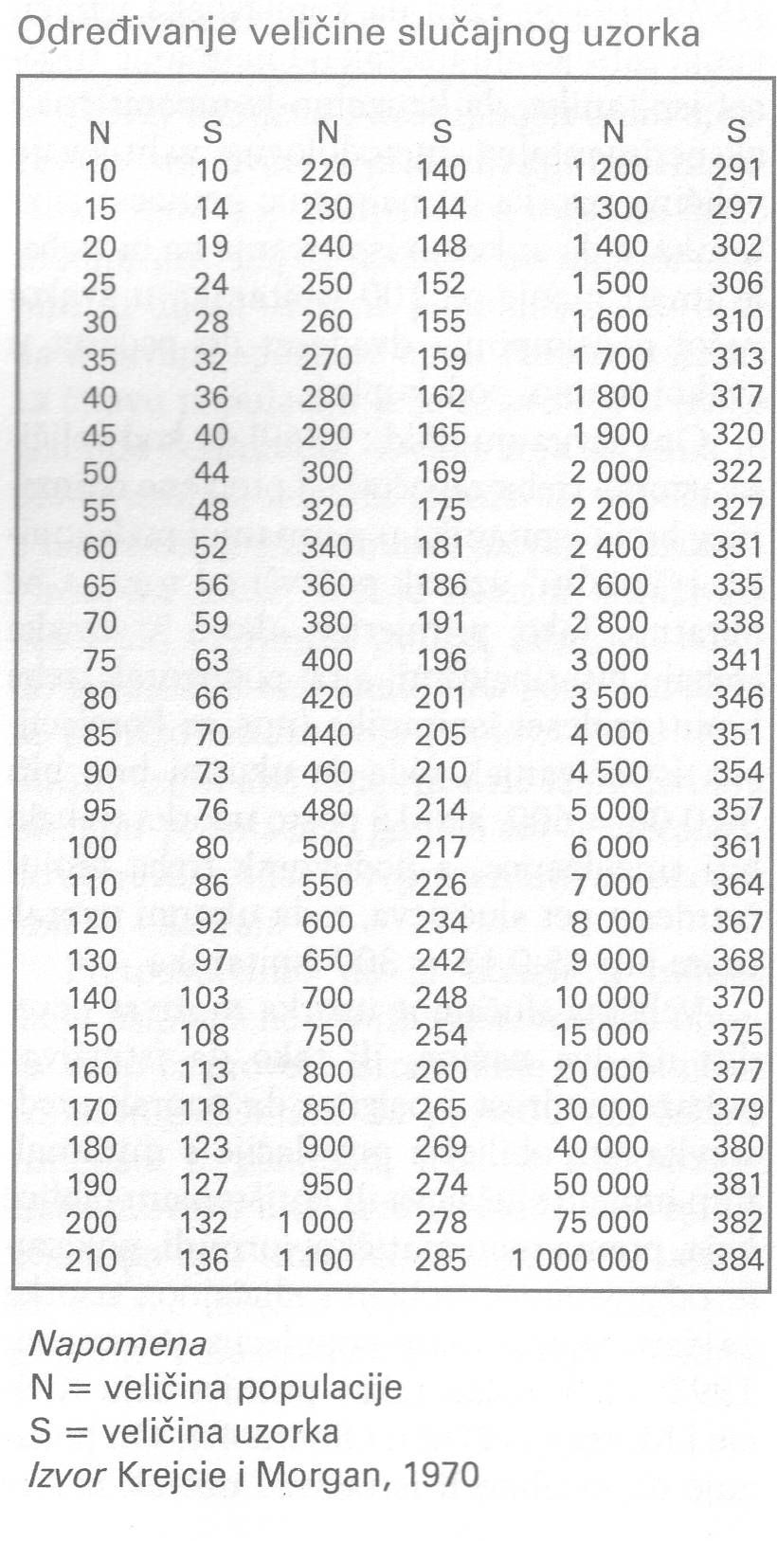
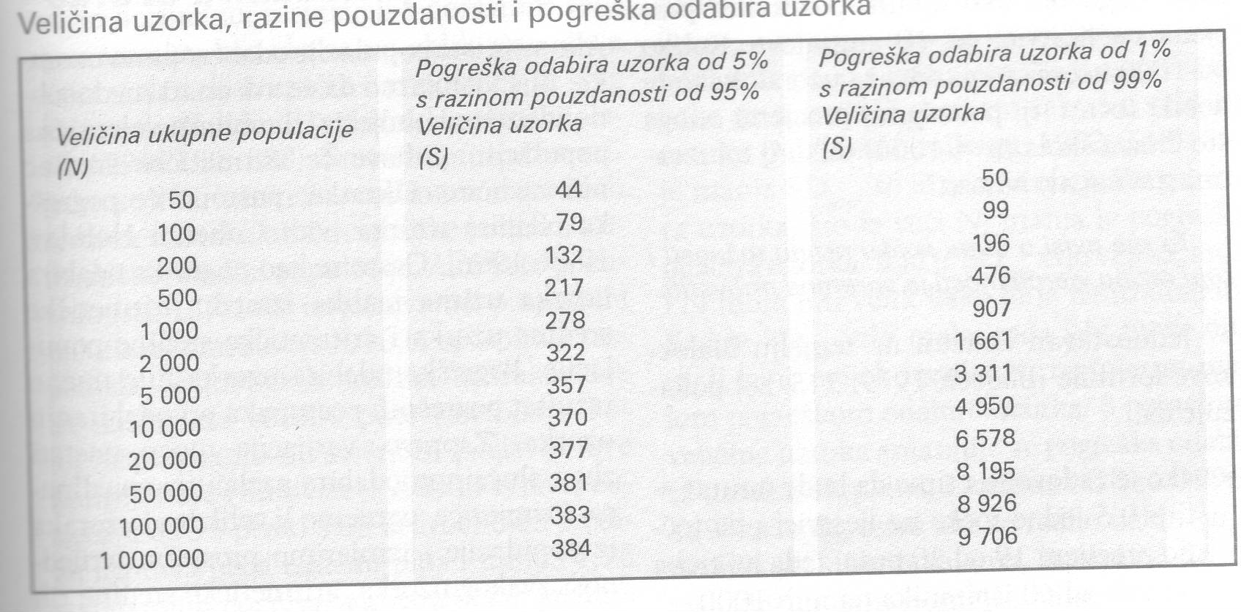
Ad 1. Sample size - no clear answer!
The smaller the number of cases in the wider total population, the greater the proportion of that population should be represented in the sample. The opposite is also true: the greater the number of cases in the wider, total population, the smaller the proportion of that population should be represented in the sample.

Slide 7
Borg and GalI (1979) say that in general the sample must be large when:
1. There are a lot of variables
2. only small differences or small connections are expected or predicted
3. the sample will be divided into subgroups
4. the sample is heterogeneous in terms of the variables being studied
5. reliable measures of the dependent variable are not available
Qualitative data (researcher experience can determine sample size) and
quantitative data (precise sample size can be calculated).

Slide 8
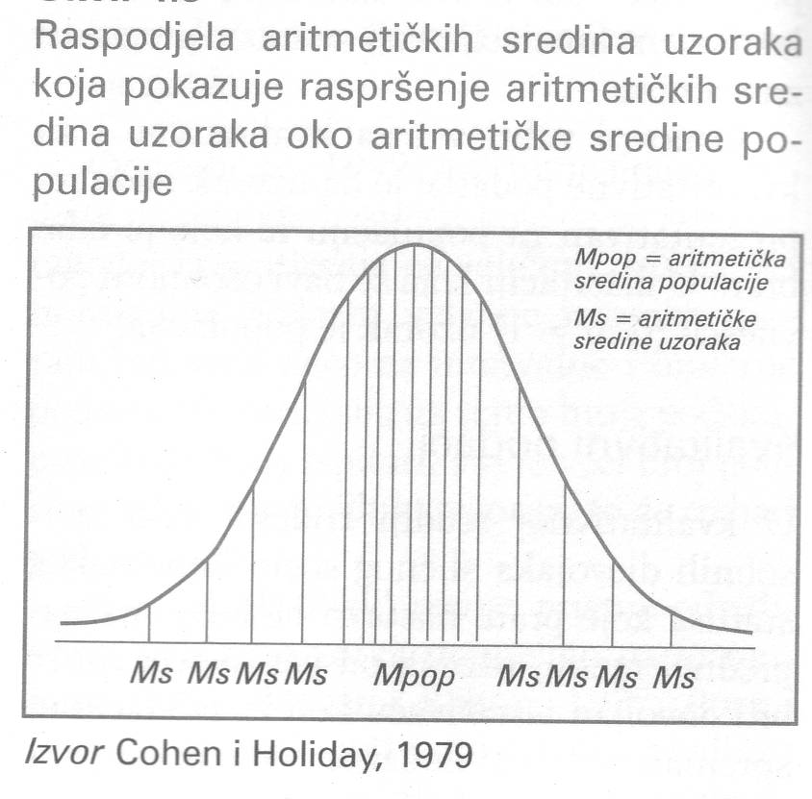
Error selecting sample
The difference between the arithmetic mean of the sample and the arithmetic mean of the population
For example, if we take a large number of samples from a population and measure the average value of each sample, the arithmetic means of these samples will not be the same . Some will be relatively high, some relatively low, and many will be grouped around the average or arithmetic mean of the samples.

Slide 9
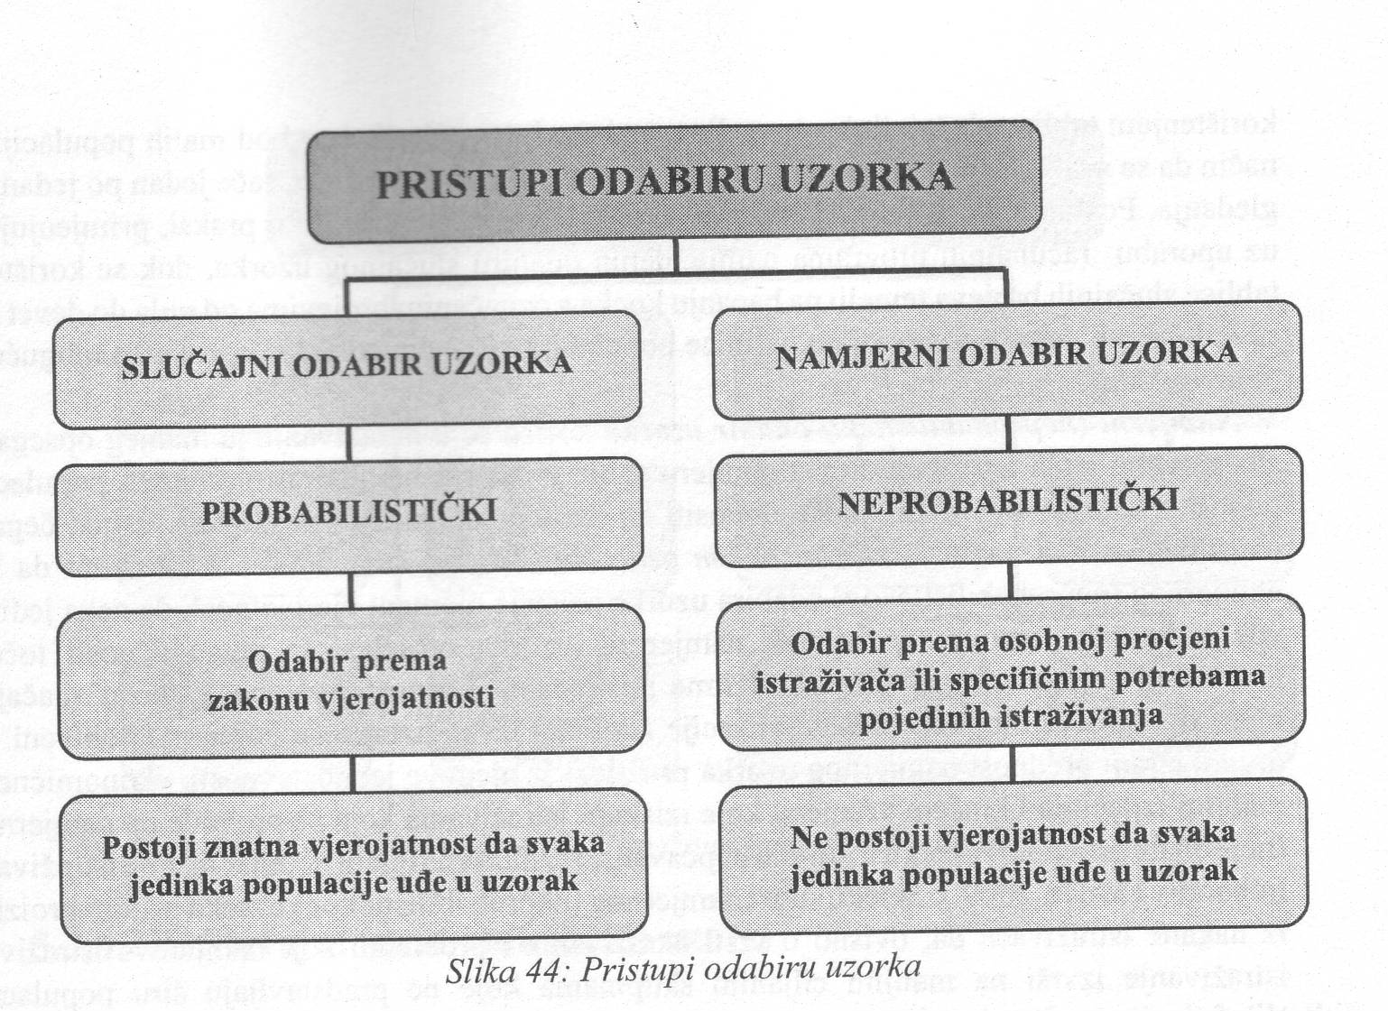
Other factors
  Representativeness and basic parameters of the sample
  Sample access (possible and practical)
  Sample selection strategy

Slide 10
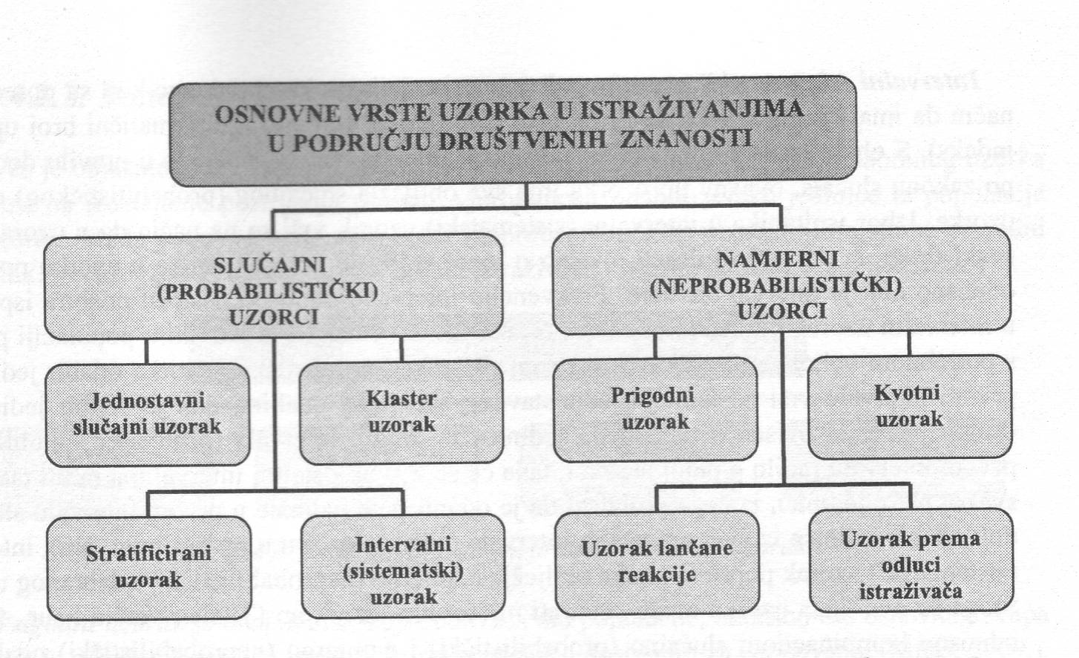
Types of sample

Slide 11
In simple random samples , each member of the population under study has an equal chance of being selected, and the probability that an individual member of the population will be selected is not influenced by the choice of other members of the population, ie each selection is completely independent of the next.
Stratified sample selection involves dividing the population into homogeneous groups, and each group contains subjects with similar characteristics. For example, group A may contain men and group B women.
cluster sample is used when the population is very large and heterogeneous, so the selection of a random sample is based on the selection of (strict) parameters, in order to justify the generalization of conclusions.
In the case of an interval (system) sample, we form an interval of a certain width, depending on the desired reliability (or trust) estimates - the wider the interval, the more reliable the estimate, i.e., the arithmetic mean of the population is more likely to be found in it .

Slide 12
Selecting a suitable sample involves selecting the closest individuals as respondents and continuing the process until the required sample size is reached.
Quota sample selection is described as the non-random equivalent of the stratified sample . Like a stratified sample, the quota sample tries to represent significant features (strata) of the wider population; however , _ unlike the stratified sample, the intention of the quota sample is to represent these characteristics in the proportions in which they can be found in the wider population.
In the selection of the chain reaction sample or the so-called type "avalanche" researchers identify a small number of people who have characteristics that interest them. These people are then used as informants in order to identify or put the researchers in contact with others who can be involved, and they in turn identify the next respondents - hence the name "avalanche type sample".
The sample according to the decision of the researcher depends on the knowledge, experience and characteristics of the research being conducted. It can be intentional (undisguised) or accidentally selective and biased.

Slide 13
Questions (1)
Is the sampling procedure used in the promotion of films in the context of film announcements ( trailer )? Is the sample obtained representative?
Comment on the following pattern designs:
The civic association is interested in raising public and financial support around the construction of the university campus and is physically sharing a questionnaire. They are waiting for answers by e-mail.

Slide 14
Questions (2)
Comment on the following pattern designs:
The store wants to find out if it is losing or gaining customers with a new product line, so they are conducting research by compiling a sample consisting of every 10th person on its list of customers who use credit cards.
The motorcycle manufacturer decides to research the characteristics of motorcycle riders in order to focus on advertising messages, so it sends 100 questionnaires to each of its vendors. Vendors find on the list of buyers those who buy these motorcycles and send them questionnaires.

Slide 15
Questions (3)
Comment on the following pattern designs:
The director of a marketing agency wants to know how effective a particular ad is. In one magazine he rented a page with an ad on half of the page and a short questionnaire on the other half. The prize will be given to the first 1000 people who send a questionnaire.
The research agency obtains a sample for the focus group using the resources of organized groups (churches, clubs, schools). They pay a fee to the organizers of the gathering because they provide them with respondents. Respondents are not paid a fee.

Slide 16
Questions (4)
Comment on the following pattern designs:
The researcher proposes that the method of keeping a consumer diary be replaced by a sample of consumers to whom the purchased goods will be optically scanned. The potential problem of people recording a purchase is being replaced by computer data.
The ad on the business website reads: “Are you a manager in a large company? Solve the survey and earn 200 kn! ” Is this a convenient way to choose a manager?

Slide 17
Questions (5)
In order to ensure a quality working session, the company selected members for the focus group who articulate, did not conduct a random selection. The client who commissioned the survey did not ask about sample selection. Is this a correctly selected sample?

