Slide 1
TASKS

Slide 2
Tasks
Go to The Economist's website (https://www.economist.com/) and check out the headlines. Comment on why the selected news would fall under "economic" news.
On the portal of Croatian scientific and professional journals Hrčak (https://hrcak.srce.hr/index.php?show=casopisi_podrucje&id_podrucje=46&status=1), randomly select one economic journal, last year and one article and see what it is about in the context of economic methodology (framework of thinking, problems, methods used).
Let's look at a passage from Adam Smith's The Wealth of Nations. Compare that part with the text you found on Hrčak. Do you notice any changes in the way you write, think?
Fill in the crossword puzzle.

Slide 3
Horizontal :
Vertical :
N
.
N
.

Slide 4
Solutions
1 = METHOD
2 = POSITIVE (vertical) / PROBLEM (horizontal)
3 = DEDUCTION
4 = INDUCTION
5 = ASSUMPTION
6 = GENERALIZATION
7 = HYPOTHESIS
8 = SHORTNESS
9 = REFUSAL
Horizontal :
Vertical :

Slide 5
THE BEGINNING OF SCIENTIFIC METHODS

Slide 6




Knowledge building
How can we acquire knowledge?

Slide 7
Scientific method
What is a scientific method? It allows us to test the credibility of our scientific claims or hypotheses and the strength of empirical evidence !!!
How do you know if a study is a scientific study?
PRINCIPLES:
  Empirical assessment
  Replication
  Objectivity
  Transparency
  Possibility of refutation
  Logical consistency

Slide 8
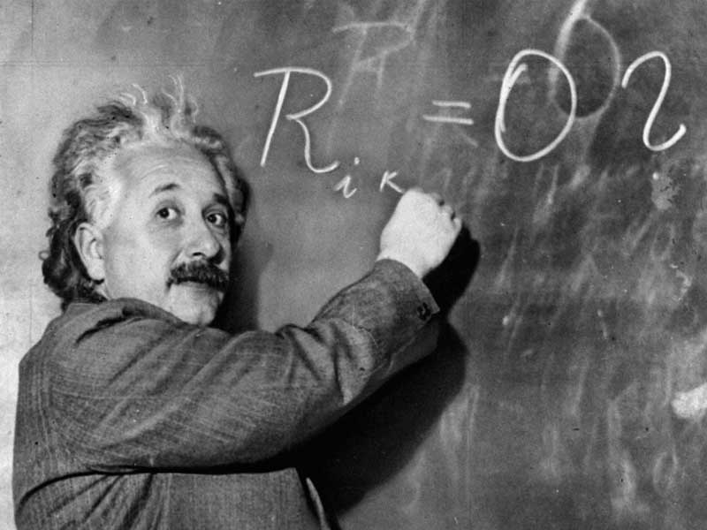
Terms - types of scientific claims
Observations - accurate but also inaccurate view of the world…
Hypotheses - a statement that describes a pattern, regularity, or general relationship
Theories - is based on hypotheses whose evidence strongly supports it
Laws - very precise description or connection in regularities (samples)

Slide 9
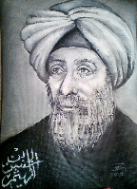
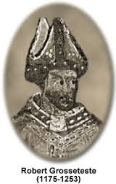
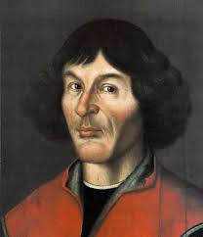
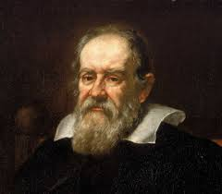
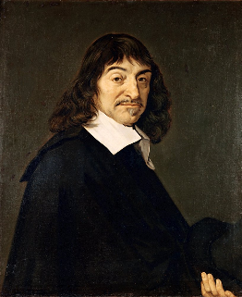
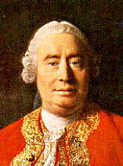
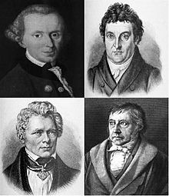
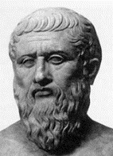
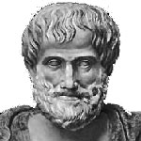
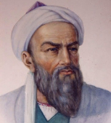
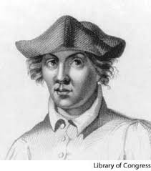
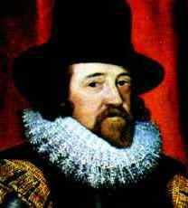
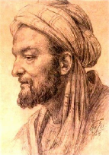
HISTORICAL DEVELOPMENT AND DEFINITION OF SCIENCE (1)
The importance of science - the sum of knowledge of objective reality whose truth can be verified
Ancient, Medieval (and Renaissance) and Modern Science
Discontinuity of science development
-400.pK. -300 pk 1000.g. 1250 1500. 1600. 1650. 1750. 1800.
Plato Aristotle Ibn al-Hasan Grosseteste Copernicus Galilei Rene Descartes David Hume njem. idealists
Al Biruni, Ibn Sina Roger Bacon Francis Bacon

Slide 10
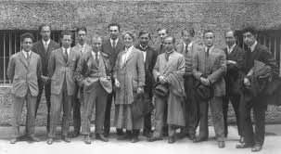
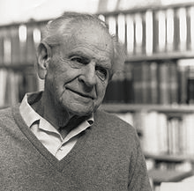
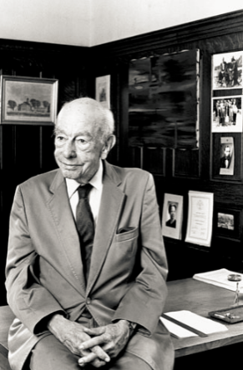
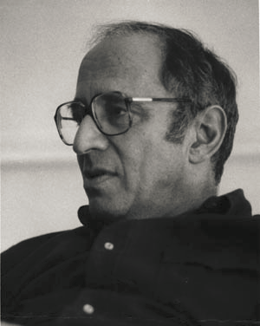
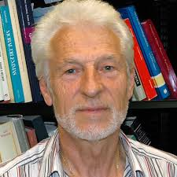
HISTORICAL DEVELOPMENT AND DEFINITION OF SCIENCE (2)
1900. in the 1990s/2000. born 1941
The Vienna Circle - Logical Positivism Karl Popper Willard van Orman Quine Thomas Kuhn Bas van Frassen

Slide 11
Traditional ec. methodology - requires compliance with some strict methodological rules - deals with the research of general methodological rules - "monistic"
--------------------------------------------------- -------
Modern ec. methodology - methodologically non -unique - “pluralistic”
There is no single scientific paradigm

Slide 12
Characteristics of modern science
Increase in investment in the development of scientific research
Constant increase in the number of scientists and researchers
Encouraging team research work
Accelerated multiplication of scientific information
Accelerated increase in the fund of scientific and technical-technological information
Mathematization of science
The need for advanced computer literacy

Slide 13
Beginning of research
Determining areas, fields, branches
Determining the topic
Territory | One of the fields | Branches
Social Sciences | economy | 5.01.01 Economics of Entrepreneurship 5.01.02 finance 5.01.03 quantitative economics 5.01.04 organization and management 5.01.05 international economics 5.01.06 general economy 5.01.07 trade and tourism 5.01.08 business informatics 5.01.09 macroeconomics 5.01.10 microeconomics 5.01.11 economic mathematics and statistics 5.01.12 marketing 5.01.13 accounting
Social Sciences | Information and communication sciences | 5.04.01 archival and documentary studies 5.04.02 information systems and informatics 5.04.03 librarianship 5.04.04 communication science 5.04.05 public relations 5.04.06 lexicography and encyclopedics 5.04.07 Museology 5.04.08 mass media 5.04.09 journalism 5.04.10 organization and informatics 5.04.11 information and software engineering
Technical sciences | Computer Science | 2.09.01 computer systems architecture 2.09.02 information systems 2.09.03 information processing 2.09.04 artificial intelligence 2.09.05 process computing 2.09.06 software engineering

Slide 14
Properties of a good research topic
Property | Question
Ability - is the research feasible? | Does the topic motivate us? Can we develop, if we do not already have, the skills needed to conduct research? Are we able to conduct research within a given time frame? Will the topic be relevant even after the research is completed? Can we conduct research given the financial opportunities available to us? Will we have access to data?
Adequacy - is it worth researching? | Does the topic meet the standards and conditions of the institution? Can the topic be linked to existing theory? Can we clearly and precisely define research questions and goals? Will our research provide new insights into the area? Can we connect the topic with the ideas of the organization within which we do research? Will the results be symmetrical? Does the topic fit our goals (as a student, scientist,…)?

Slide 15
Refining the research topic
Rational way of thinking
  Thinking about your own strengths, weaknesses and interests
  Research of past projects
  Discussion
  Literature research
  Media analysis
Creative way of thinking
  Keeping notes of ideas
  Analysis of personal preferences
  Relevance tree
  Brainstorming

Slide 16
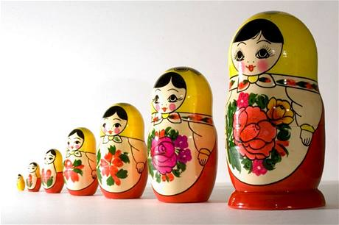
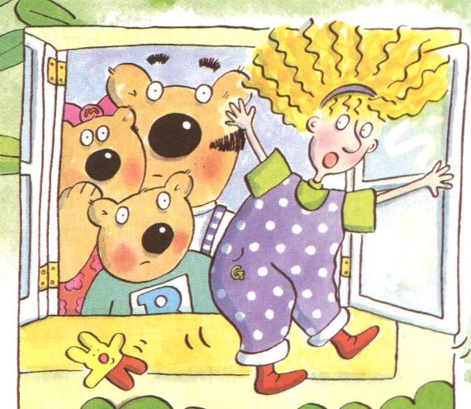
Turning an idea into a project / research
Research questions
Research Objectives - SMART
  Specific
  Measurable
  Achievable
  Realistic
  Timely
  Research goal (SMART criteria not met): Analyze the causes of unemployment
  Research goal (SMART criteria met): To analyze the causes of the growth of the unemployment rate of young people aged 20 to 29 in the Republic of Croatia in the period from 2007 to 2013

Slide 17
Steps in research
The role of theory
Writing a proposal / application topic
Description of activities | October |  |  |  | November |  |  |  |  | December |  |  |  | January
Ordinal number of the week in the month | 1 | 2 | 3 | 4 | 5 | 6 | 7 | 8 | 9 | 10 | 11 | 12 | 13 | 14 | 15
1. Collection of literary material and scientific information
2. Report the topic of the paper
3. Selection, analysis and synthesis of literature and relevant facts, knowledge, laws, theory
4. Consultations and discussions with experts, collection of expert studies and their comparison with scientific settings
5. Data analysis, revision of econometric models
6. Written formulation of research results
7. Writing text, graphic and technical processing of the paper
8. Revision of the text according to the remarks and suggestions of mentors and committee members
Key dates |  |  |  | 1 |  |  |  | 2 |  |  |  |  | 3 |  | 4

Slide 18
Determining the theoretical model and hypotheses

Slide 19

1. Determining the theoretical model
The core of the research project
It's not easy
"Can the question be interpreted in the context of theory?"
Example: Retail of diamond jewelry
Dependent variable: retail sale of diamond jewelry in Pula in 2021
Independent variables?
What if it is not clear which theory to use?
H: constructing a theoretical argument

Slide 20
2. Determining hypotheses
The form of the claim
Clearly and specifically formulated
One -dimensional , that is, to talk about one relationship
Includes at least two variables
Distinguish from alternative hypotheses
It is worded in such a way that it can be proven to the contrary
Worded in a way that can be empirically tested ( operationalization and verifiability property)
Derived from theoretical analysis, related to scientific knowledge
To be clear and one-dimensional, that is, to talk about one relationship

Slide 21
… Statistical way of formulating hypotheses
Null hypothesis (H 0 ) - a statement that we want to show is false
H 0 : There is no statistically significant relationship between the retail sale of diamond jewelry and the price of diamond jewelry in Pula in 2021
Alternative hypothesis (H 1 ) - true statement
H 1 : There is a statistically significant relationship between the retail sale of diamond jewelry and the price of diamond jewelry in Pula in 2021

Slide 22
… Descriptive way of formulating hypotheses
H: An increase in the minimum wage does not contribute to a reduction in workers' wage inequality from the lower and upper part of the wage distribution, ie does not contribute to the reduction disparity thus lacking the effect of compression

Slide 23
Tips
Research can have one or more hypotheses
The goal of formulating and testing a hypothesis is most often to test a theory
The formulation of the hypothesis allows the research to be focused
The hypothesis helps in data selection
A hypothesis can help shape a theory by allowing you to specifically infer what is true and what is not

Slide 24
HYPOTHESES; again and concluding!
to be clear and one-dimensional, that is, to speak of one relationship
be specific
have the property of operationalization and verifiability
be related to existing scientific knowledge
include at least two variables
establish a relationship between variables
have the form of a claim
be logically related to the theoretical framework and research question
have the property of subjecting statistical significance to verification

Slide 25
Questions
Your colleague wants to generate a research idea in the field of informatics. He researched his strengths and weaknesses as a researcher, his preferences for his work so far, he read articles and books but failed to come up with an idea. He asks you for advice. Recommend two techniques that your colleague can use and explain the choice.
You are interested in conducting research on launching a web portal (interface) for connecting high schools and business units. Write down three research questions that would be consistent with the research.

