Slide 1
Team 4

Slide 2

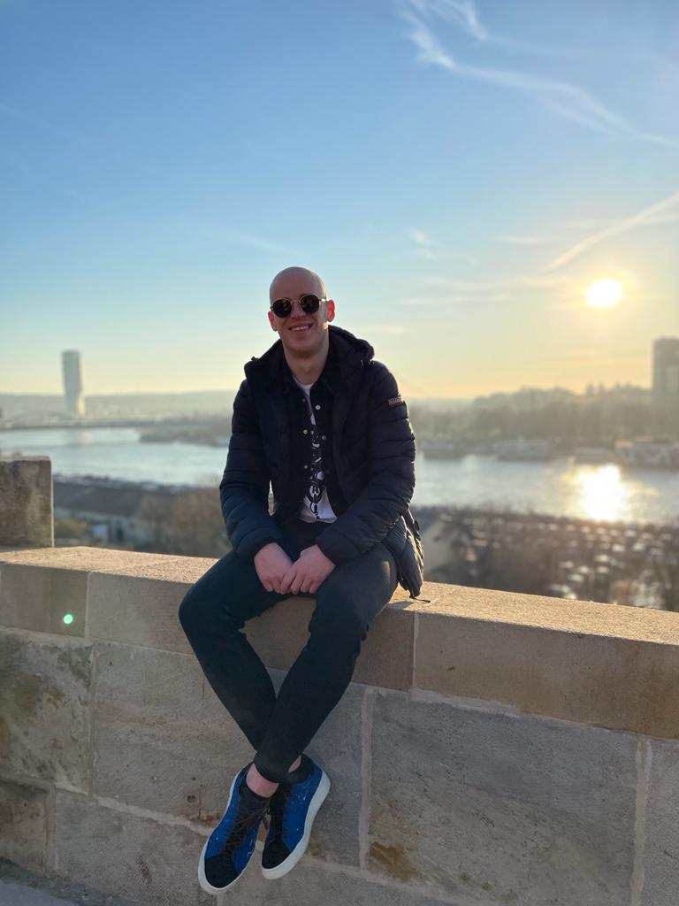
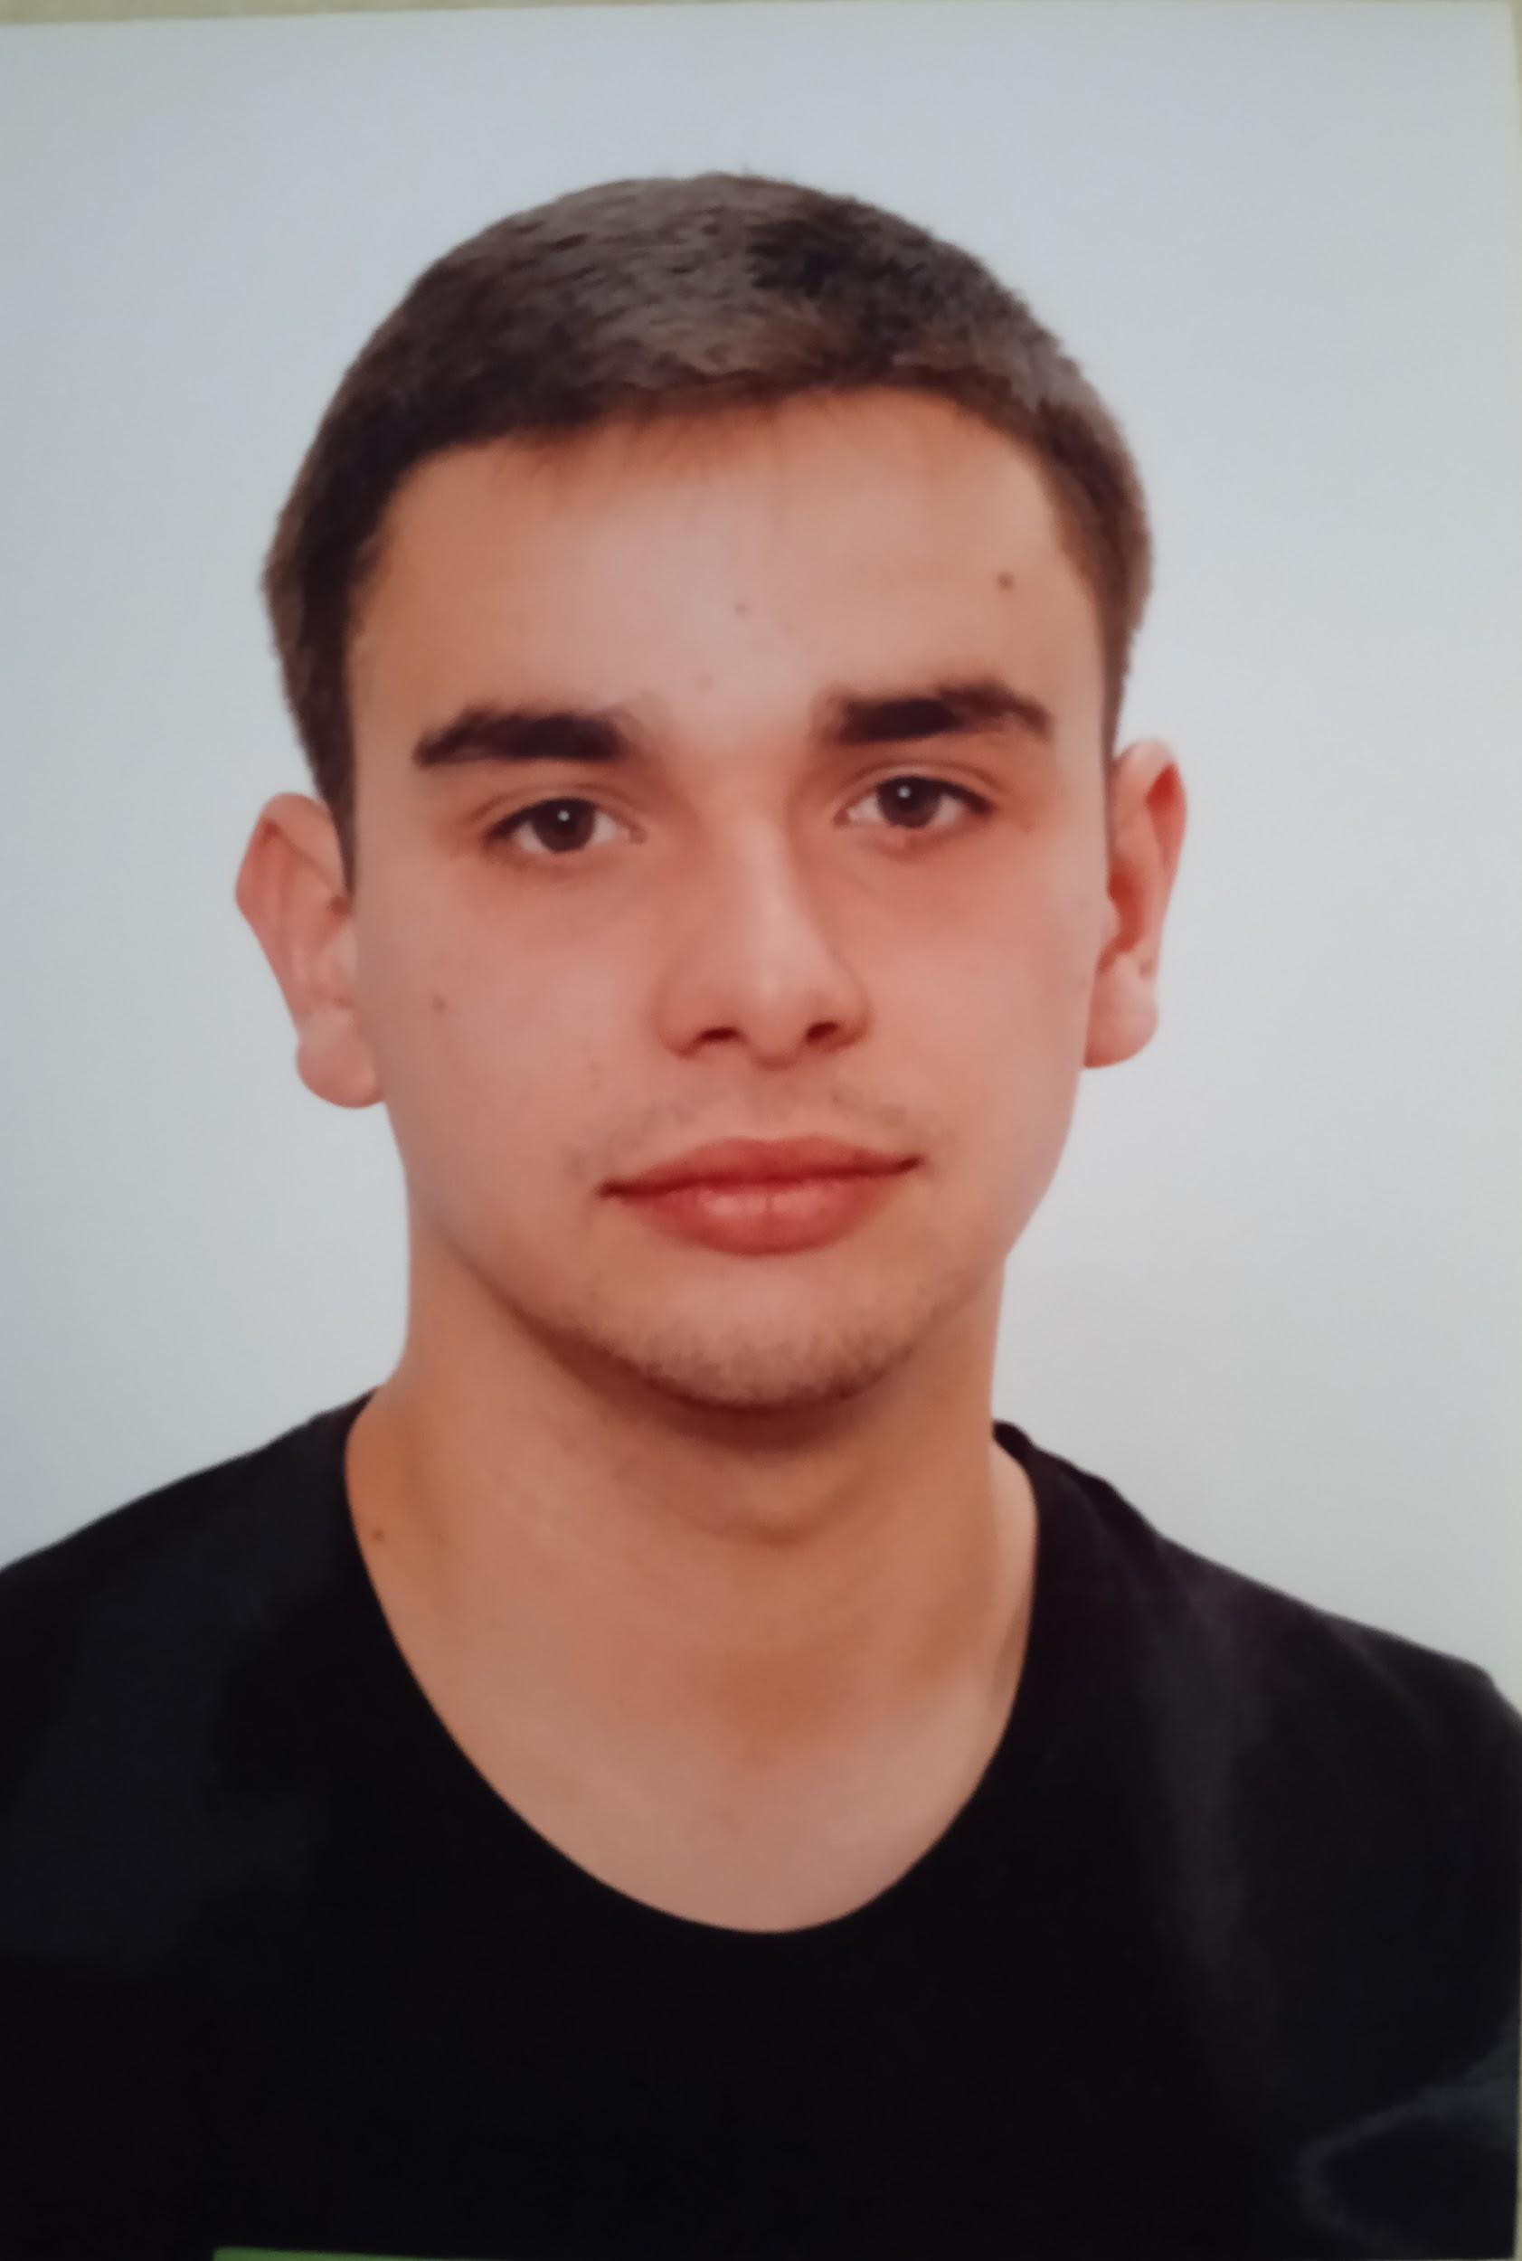
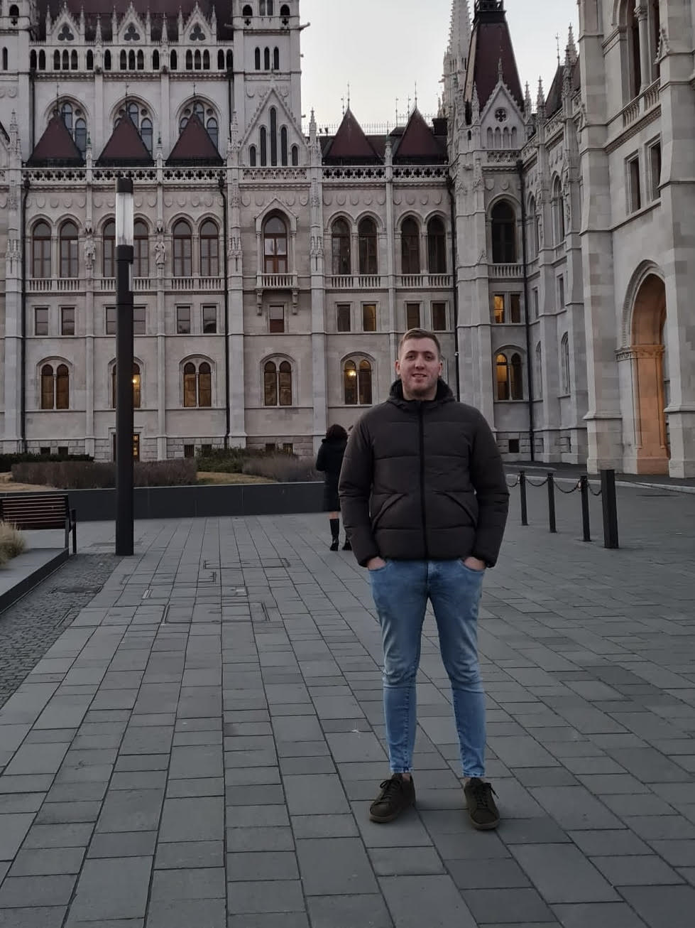
Franka Bilandžija, 23
BA: Management and enterpreneurship
MA : Management and enterpreneurship, 2nd semester
Emanuel Šegon, 23
BA: Management and enterpreneurship
MA : Management and enterpreneurship, 2nd semester
Ivan Turudić, 22
BA: Management and enterpreneurship
MA : Management and enterpreneurship, 2nd semester
Damir Mehmedagić, 23
BA: Management and enterpreneurship
MA : Management and enterpreneurship, 2nd semester

