Slide 1


Jurja Dobrila University of Pula,
Faculty of Economics and Tourism
„Dr. Mijo Mirković”
Management and entrepreneurship
Team 5 – Lack of skilled employees

Slide 2
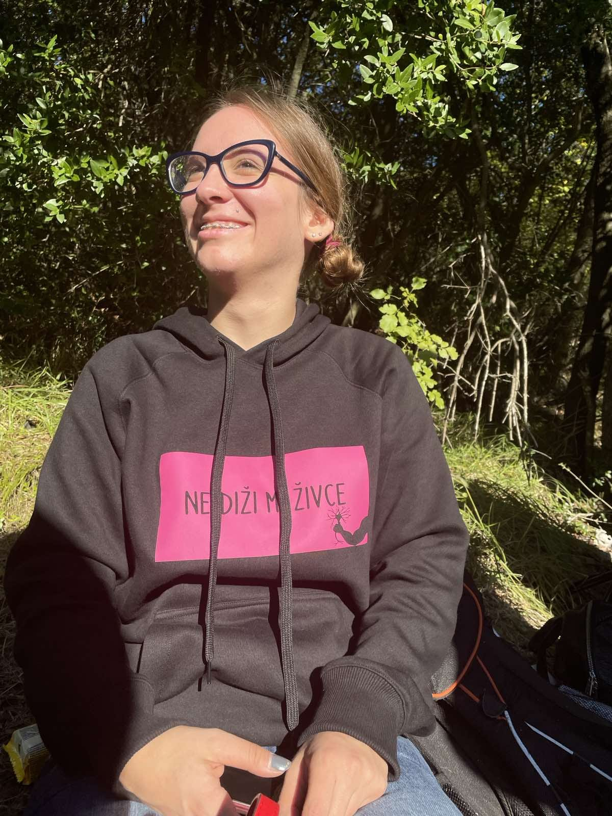
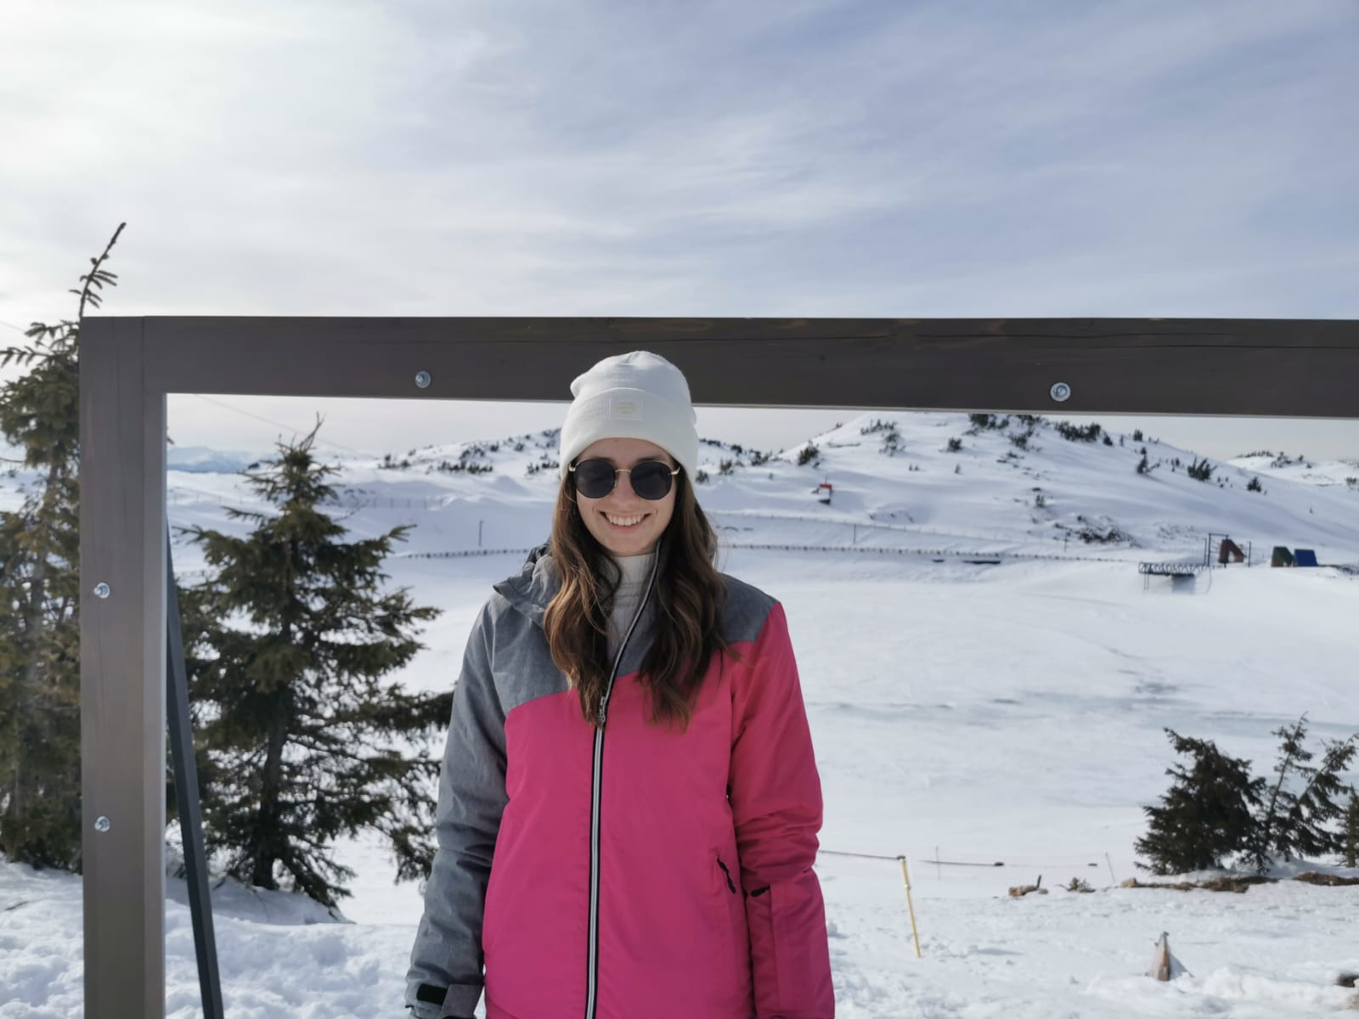
Larisa Jurkiv, 22
Slavonski Brod, Croatia
FET, Management and entrepreneurship
I love reading books, going out and walk in nature.
Andrea Vellico, 22
Bale, Croatia
FET, Management and entrepreneurship
I like traveling, going out and walking in the nature.

Slide 3
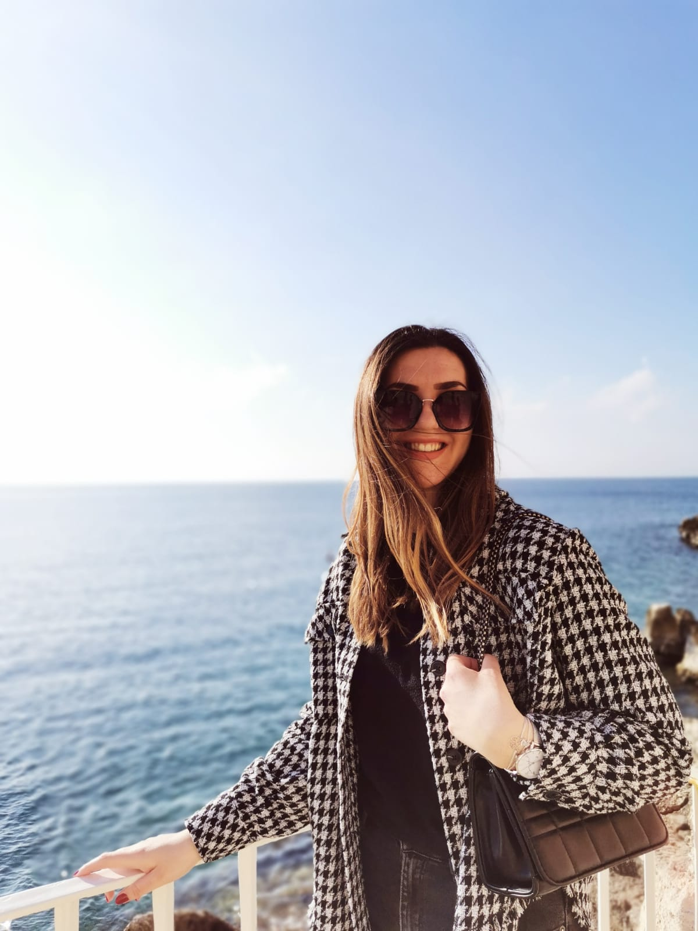
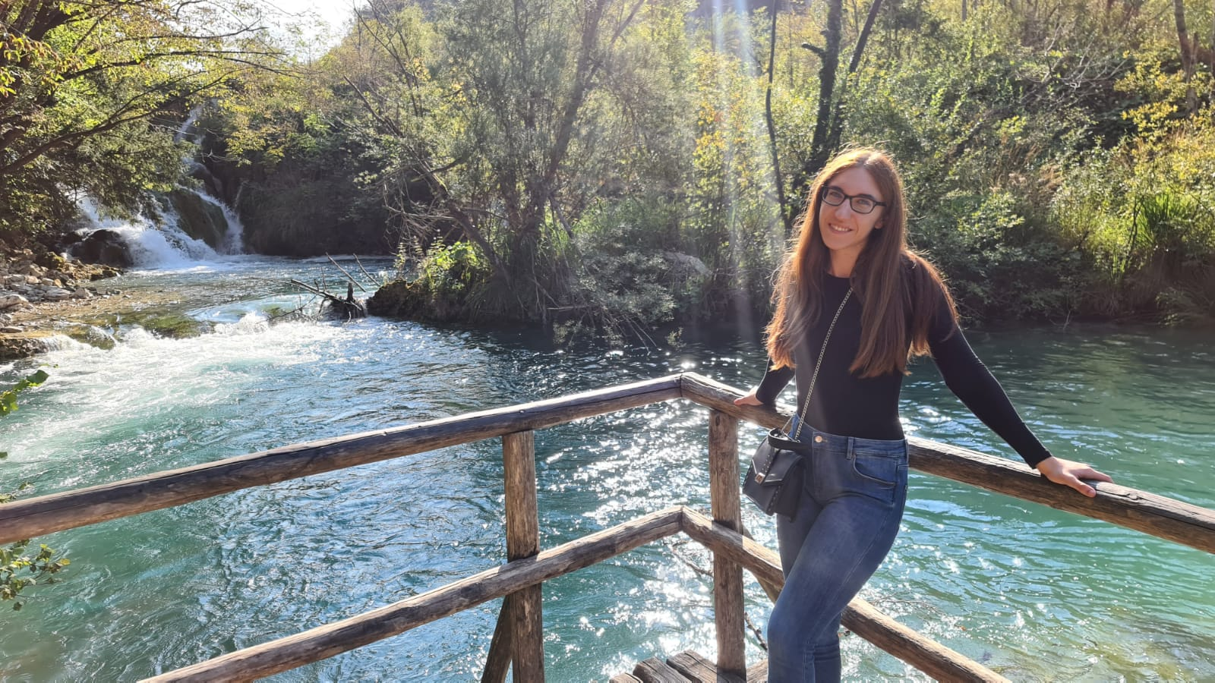
Marina Ćosić, 22
Rovinj, Croatia
FET, Management and entrepreneurship
I like sports, going out and spending time in nature.
Nina Božac, 22
Ližnjan, Croatia
FET, Management and entrepreneurship
I love working out and walk with my dog in the nature.

Slide 4


We look forward to work with you! ☺

