Slide 1
Team 2
Pula – Munich Global Business Practicum 2022

Slide 2
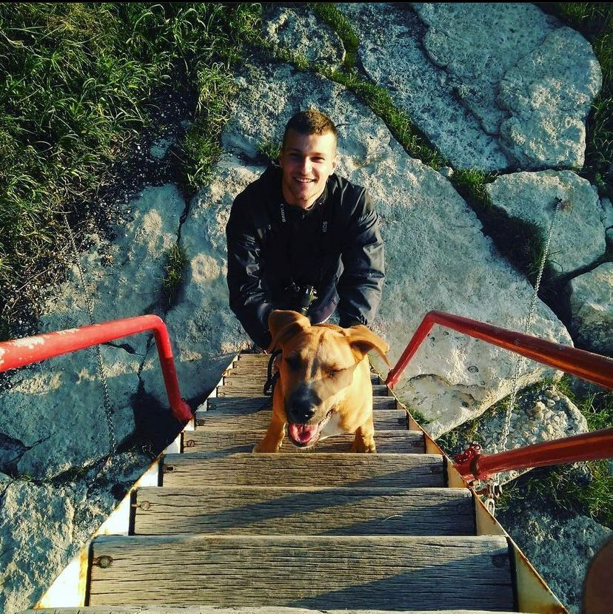
My name is Marko Šimunić
I was born in Pula
I am 28 years old
Bachelor’s degree in Management and entrepreneurship

Slide 3
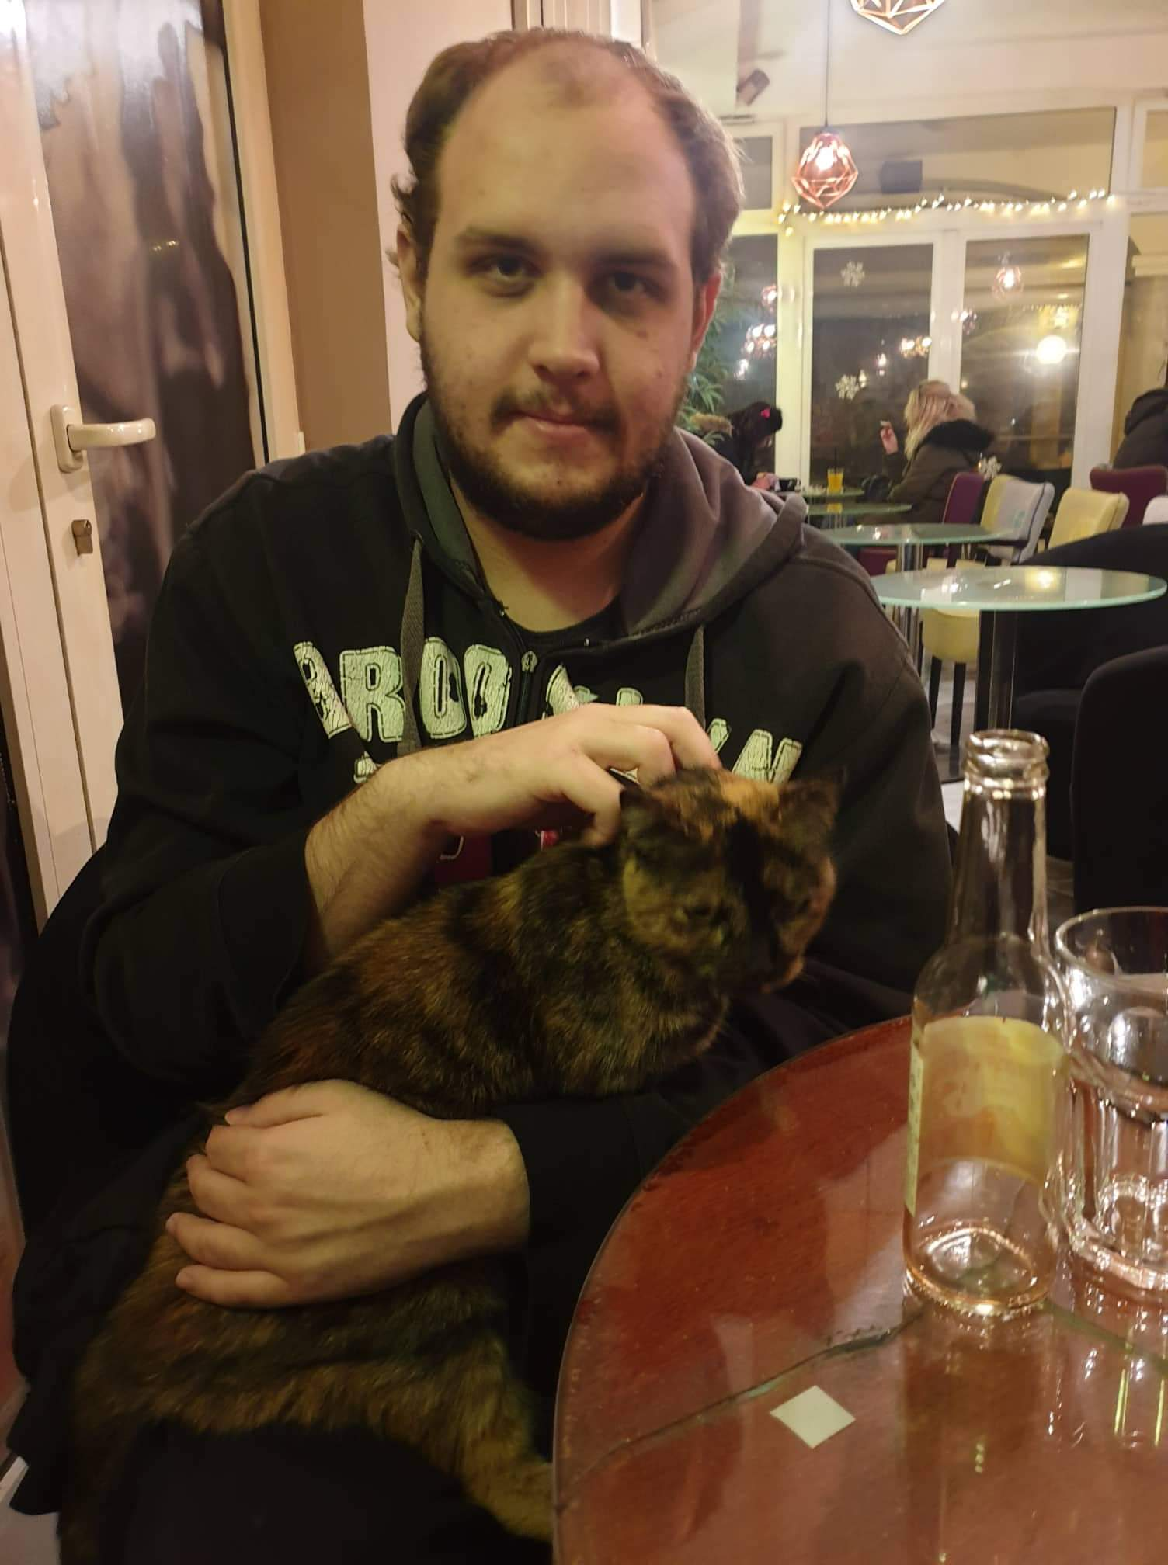
My name is Samuel Nemanić
I was born in Pula
I am 23 years old
Bachelor’s degree in Management and entrepreneurship

Slide 4
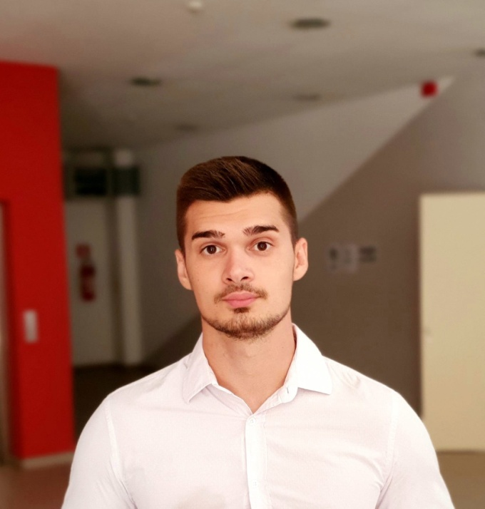
My name is Petar Barić
I was born in Vinkovci
I am 25 years old
Bachelor’s degree in Management and entrepreneurship

Slide 5
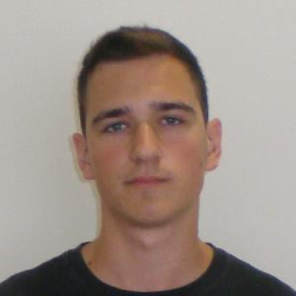
My name is Antonio Mostarkić
I was born in Pula
I am 22 years old
Bachelor’s degree in Management and entrepreneurship

