Slide 1
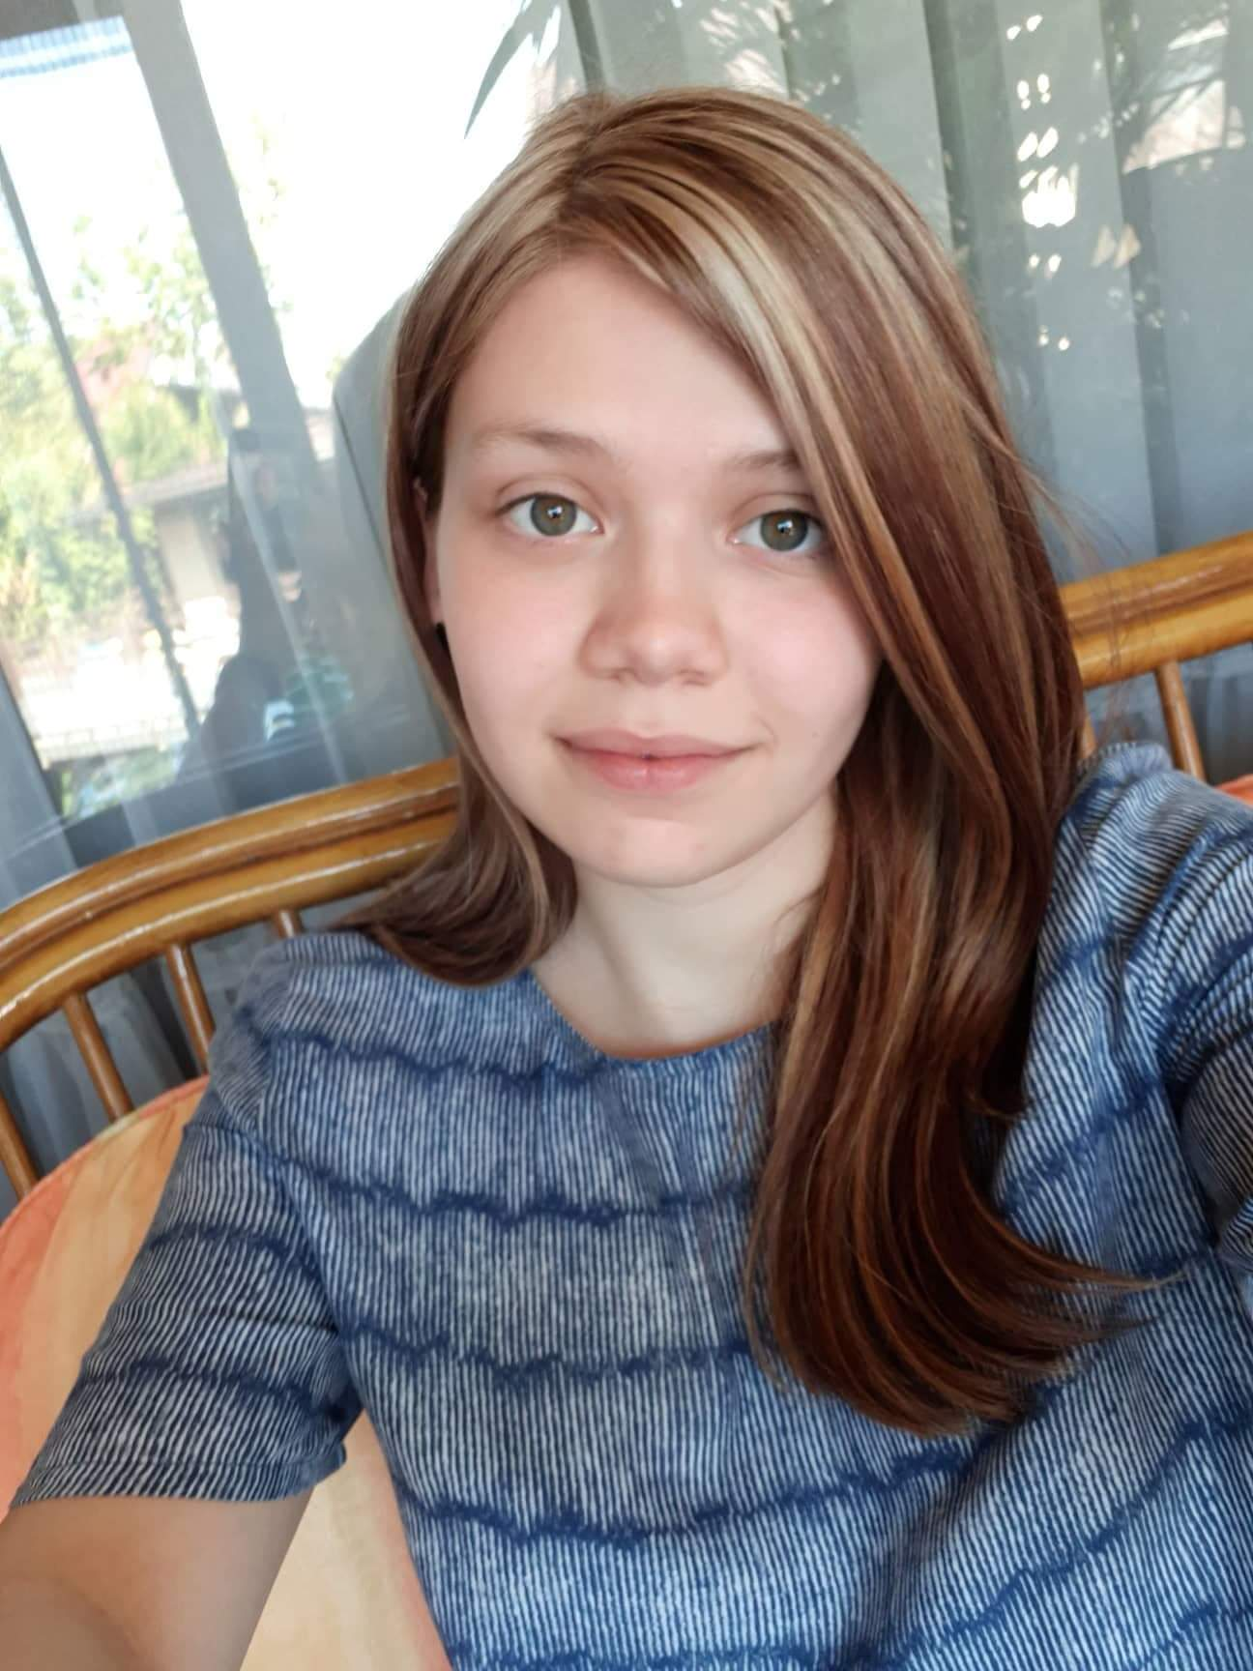
Ivona Ivančić
Hi! My name is Ivona, I’m 24 years old and I have Bachelor’s degree in managment and entrepreneurship.
My interests lies in exploring the nature and creating innovation for sustainable ecosystem.

Slide 2
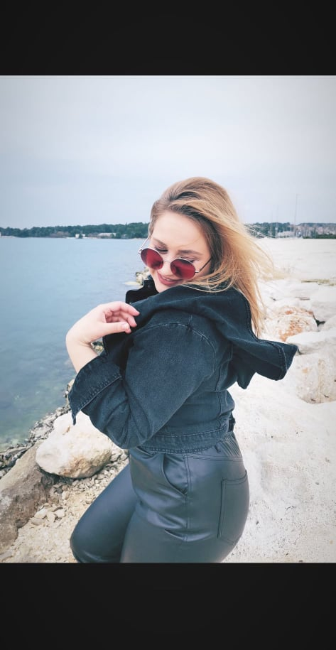
Stela Huljev Lesandro
♥
♥
Hey there, my name is Stela, I’m 22 years old and have a Bachelor's degree in management and entrepreneurship. I’m especially interested in emotional intelligence in business and human resource management.

Slide 3
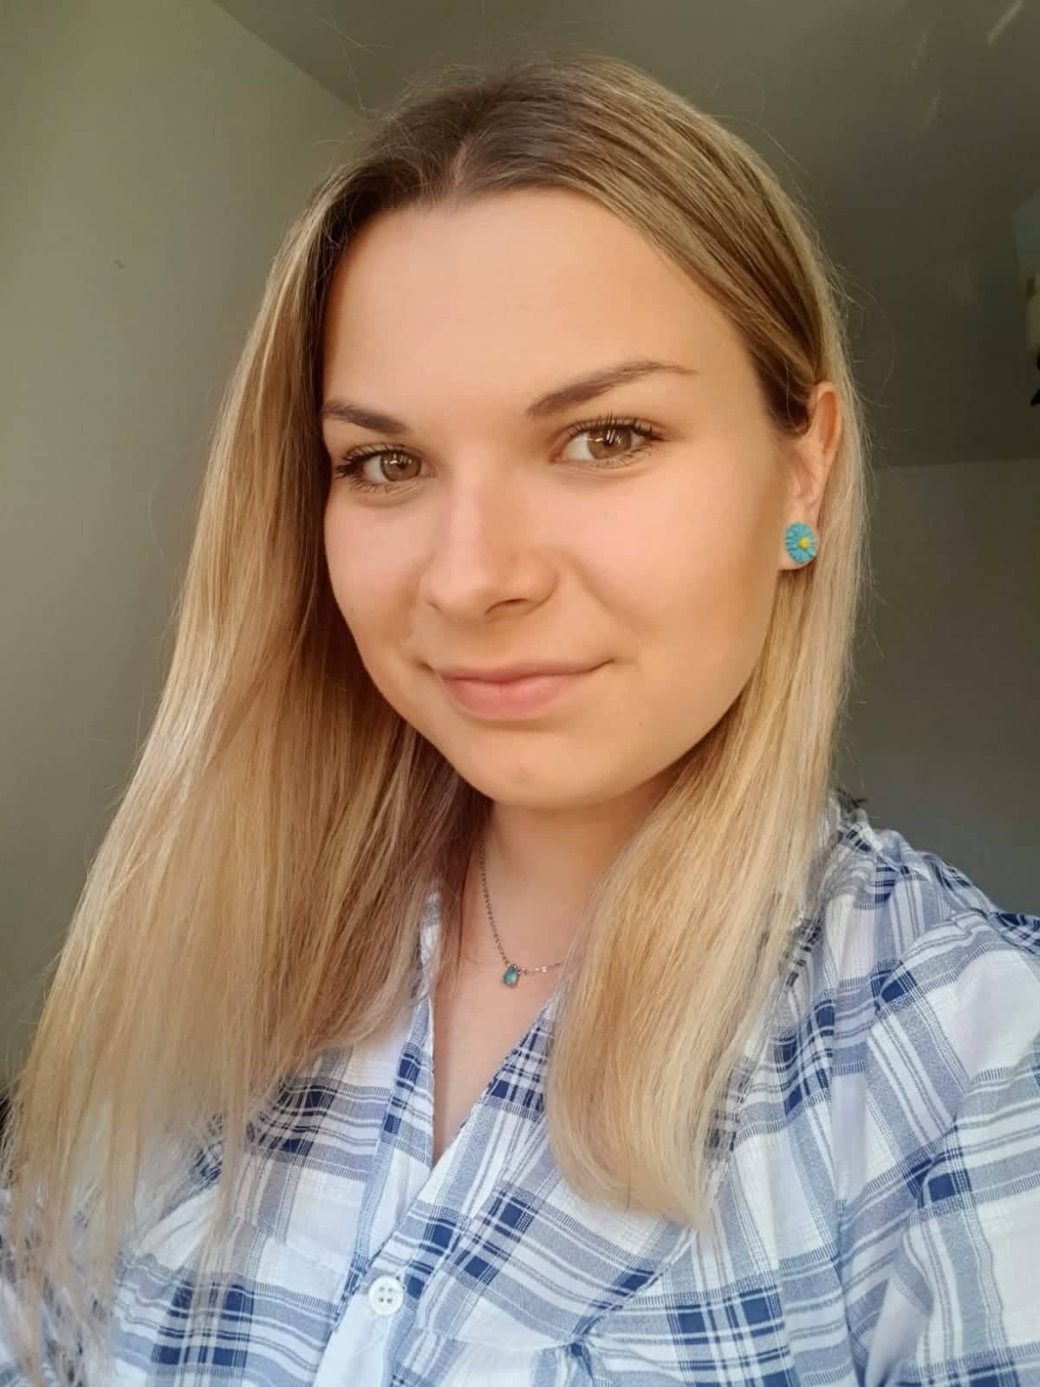
Ana-Maria Furdi
Hi, my name is Ana-Maria. I'm 24 years old and have a degree in economics.
I am studying management and entrepreneurship and I would like to open a private company.

